Slide 1
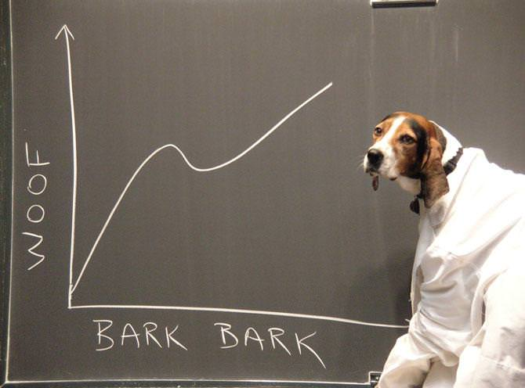
CMSC250
Spring ‘21
PANDEMIC
POLITICAL ARMISTICE
DISCRETE MATHEMATICS
Google slides link if the PPTX/PDF doesn’t work

Slide 2
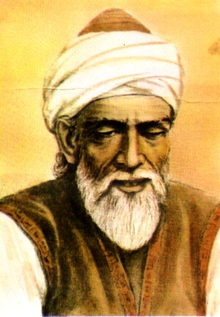
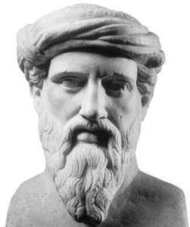
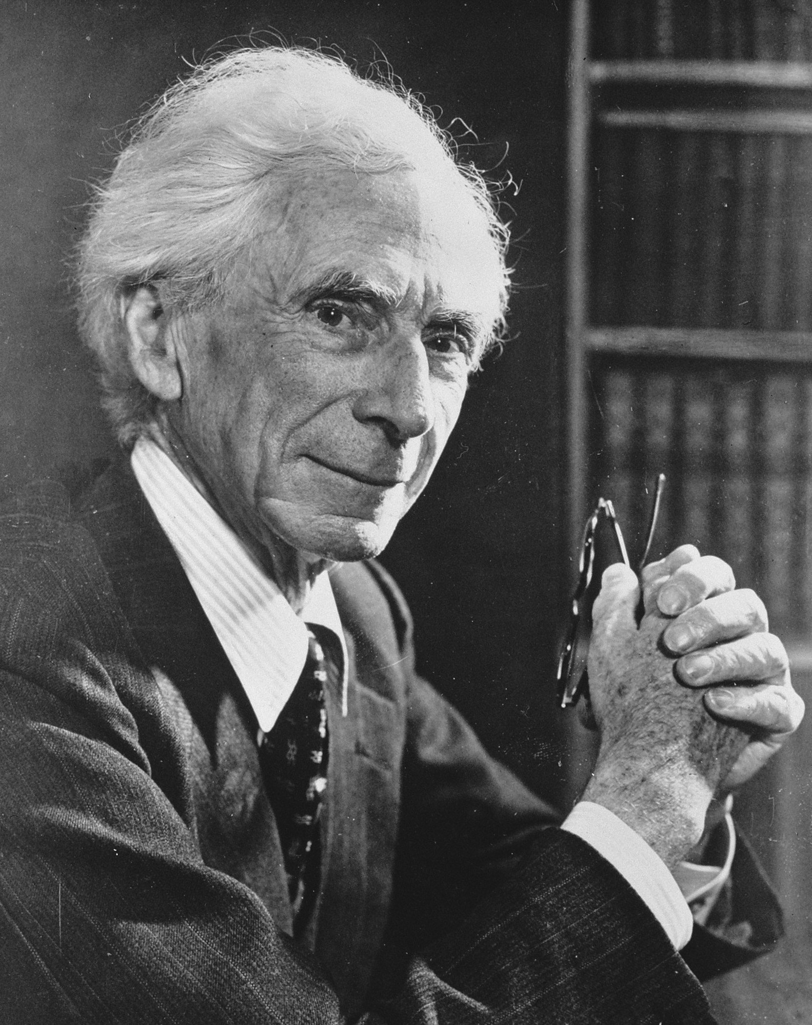
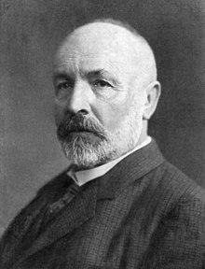
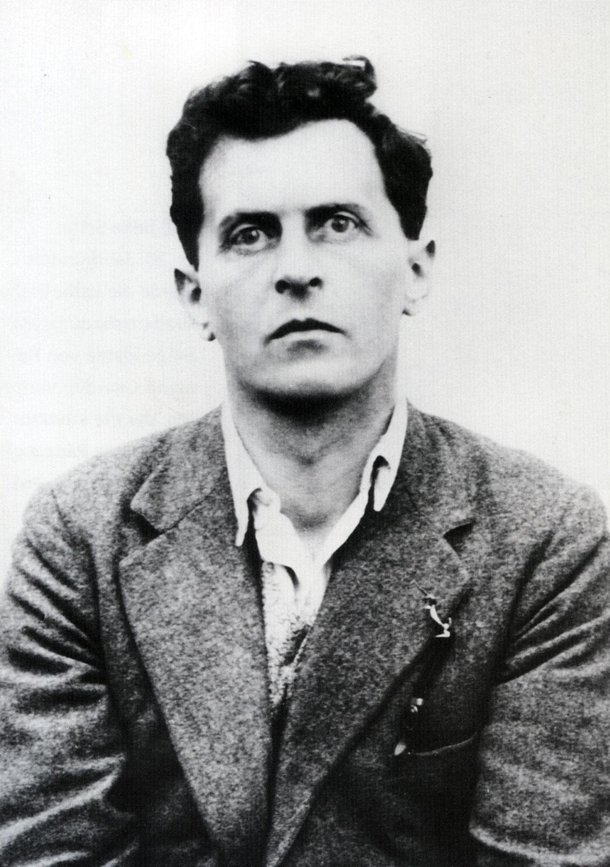
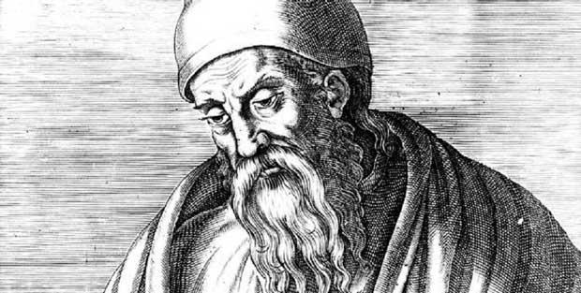
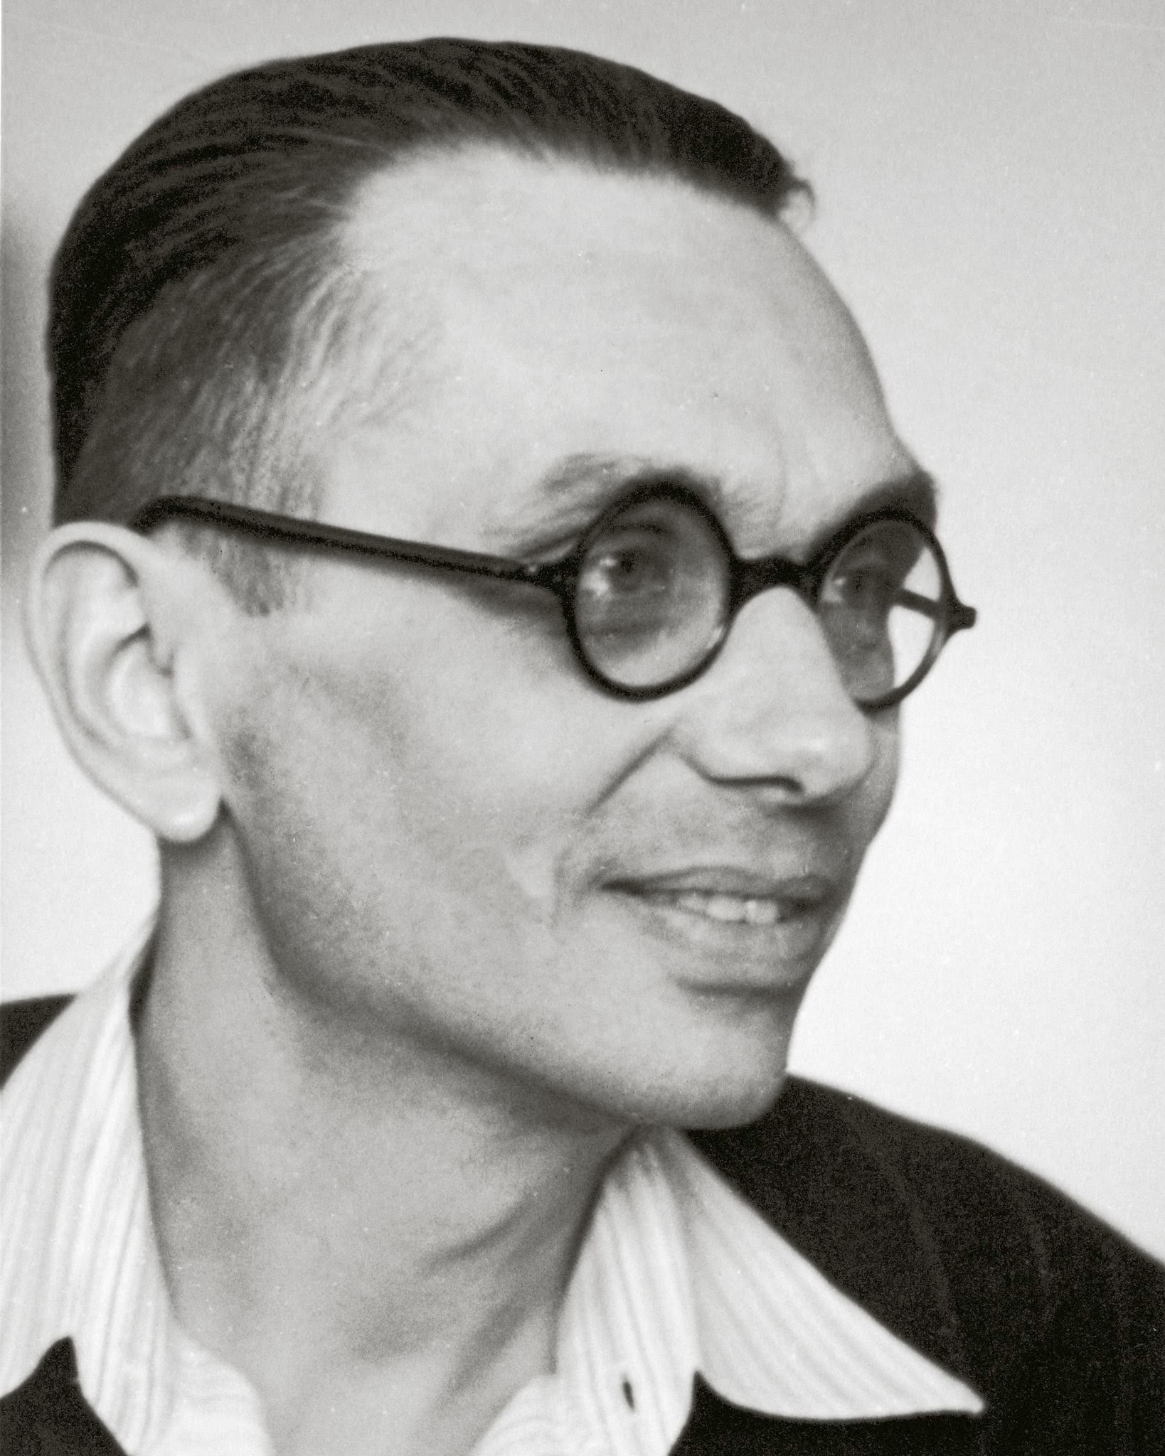
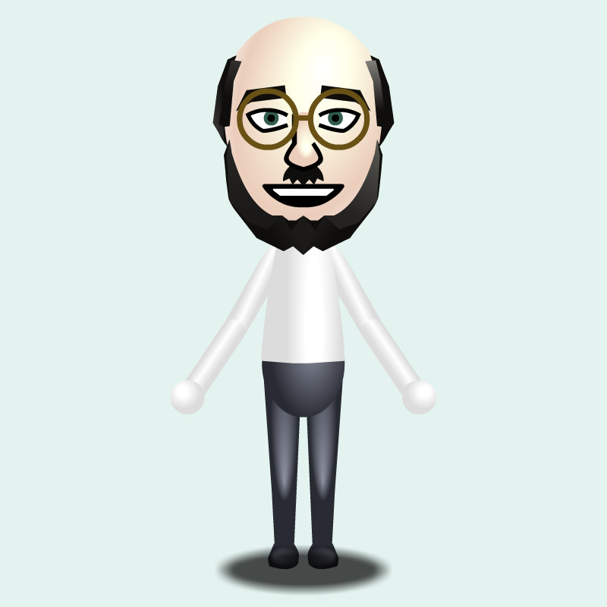
Welcome!

Slide 3
The course

Slide 5

Goal of 250
Graph Theory
Game Theory
Classical AI
Stochastic logic
451(Algo II)
Crypto
Symbolic Logic
Ramsey Theory
Weird Set Theories
351 (Algo I)
Advanced Combinatorics
Theory of Computation
250

Slide 6


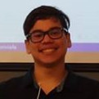
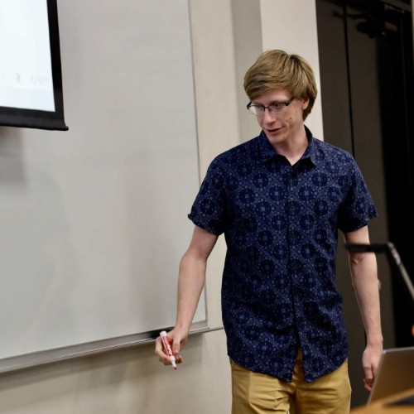
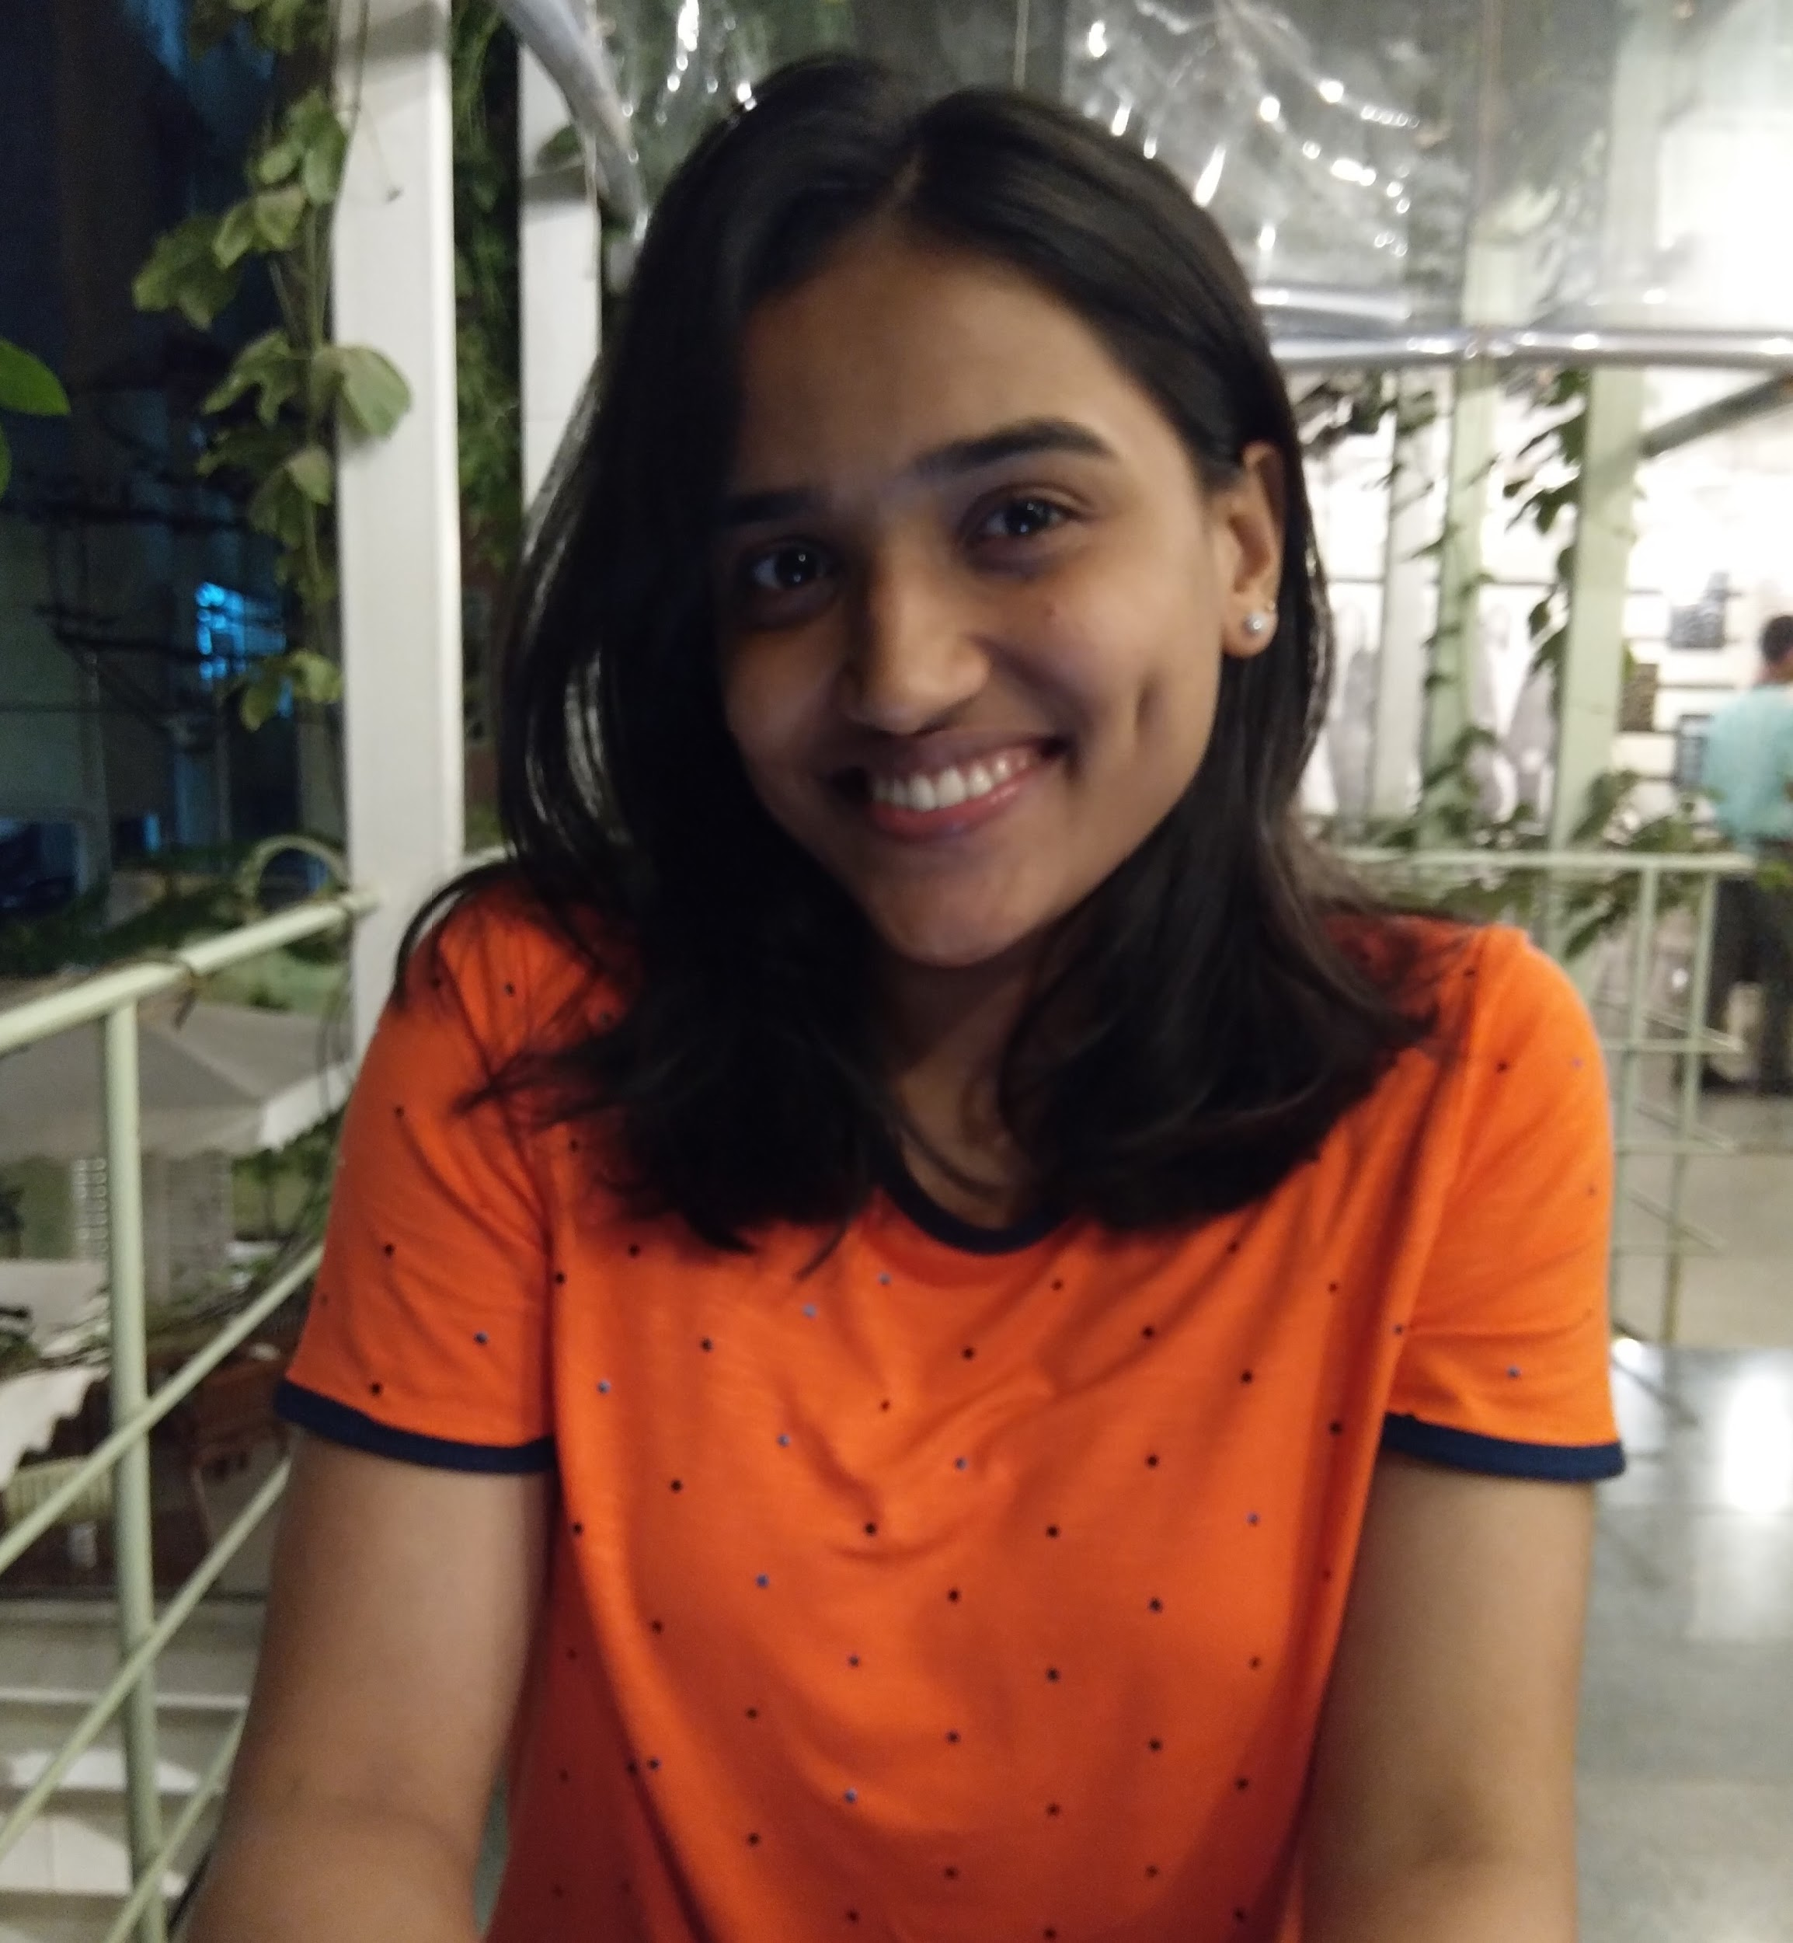
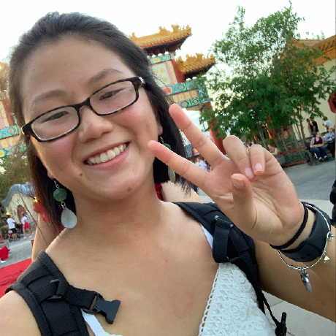
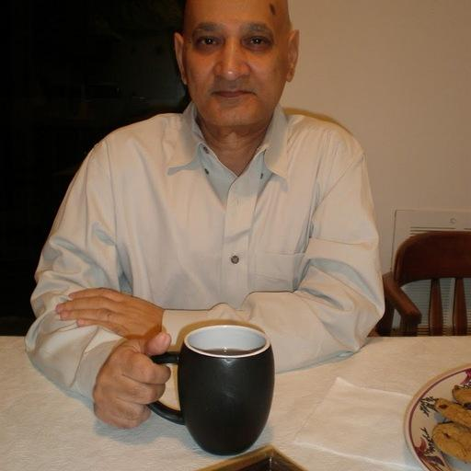
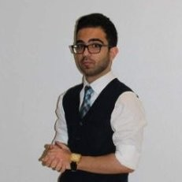
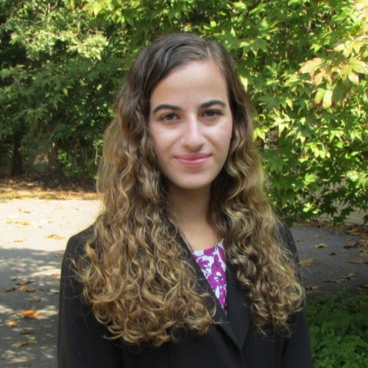
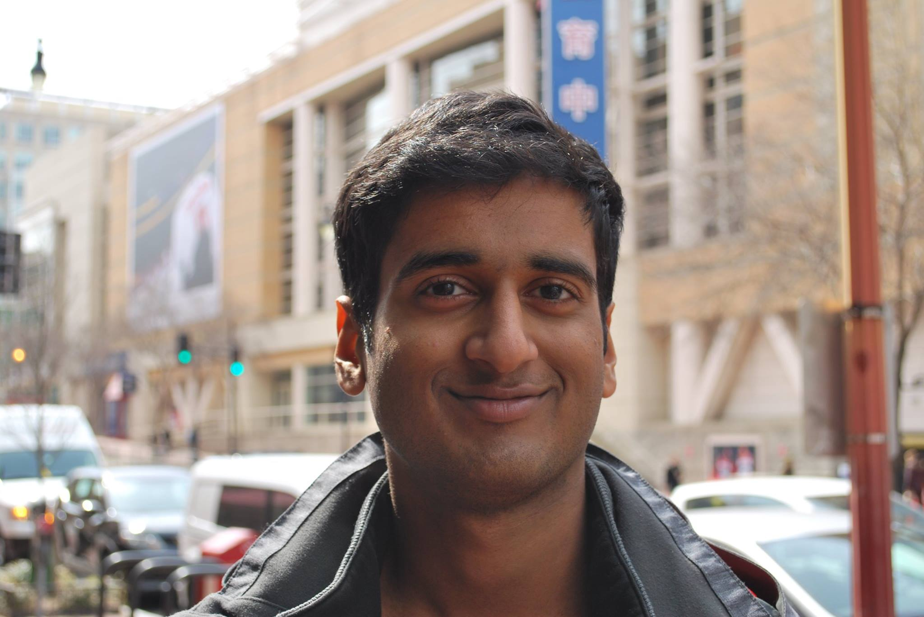

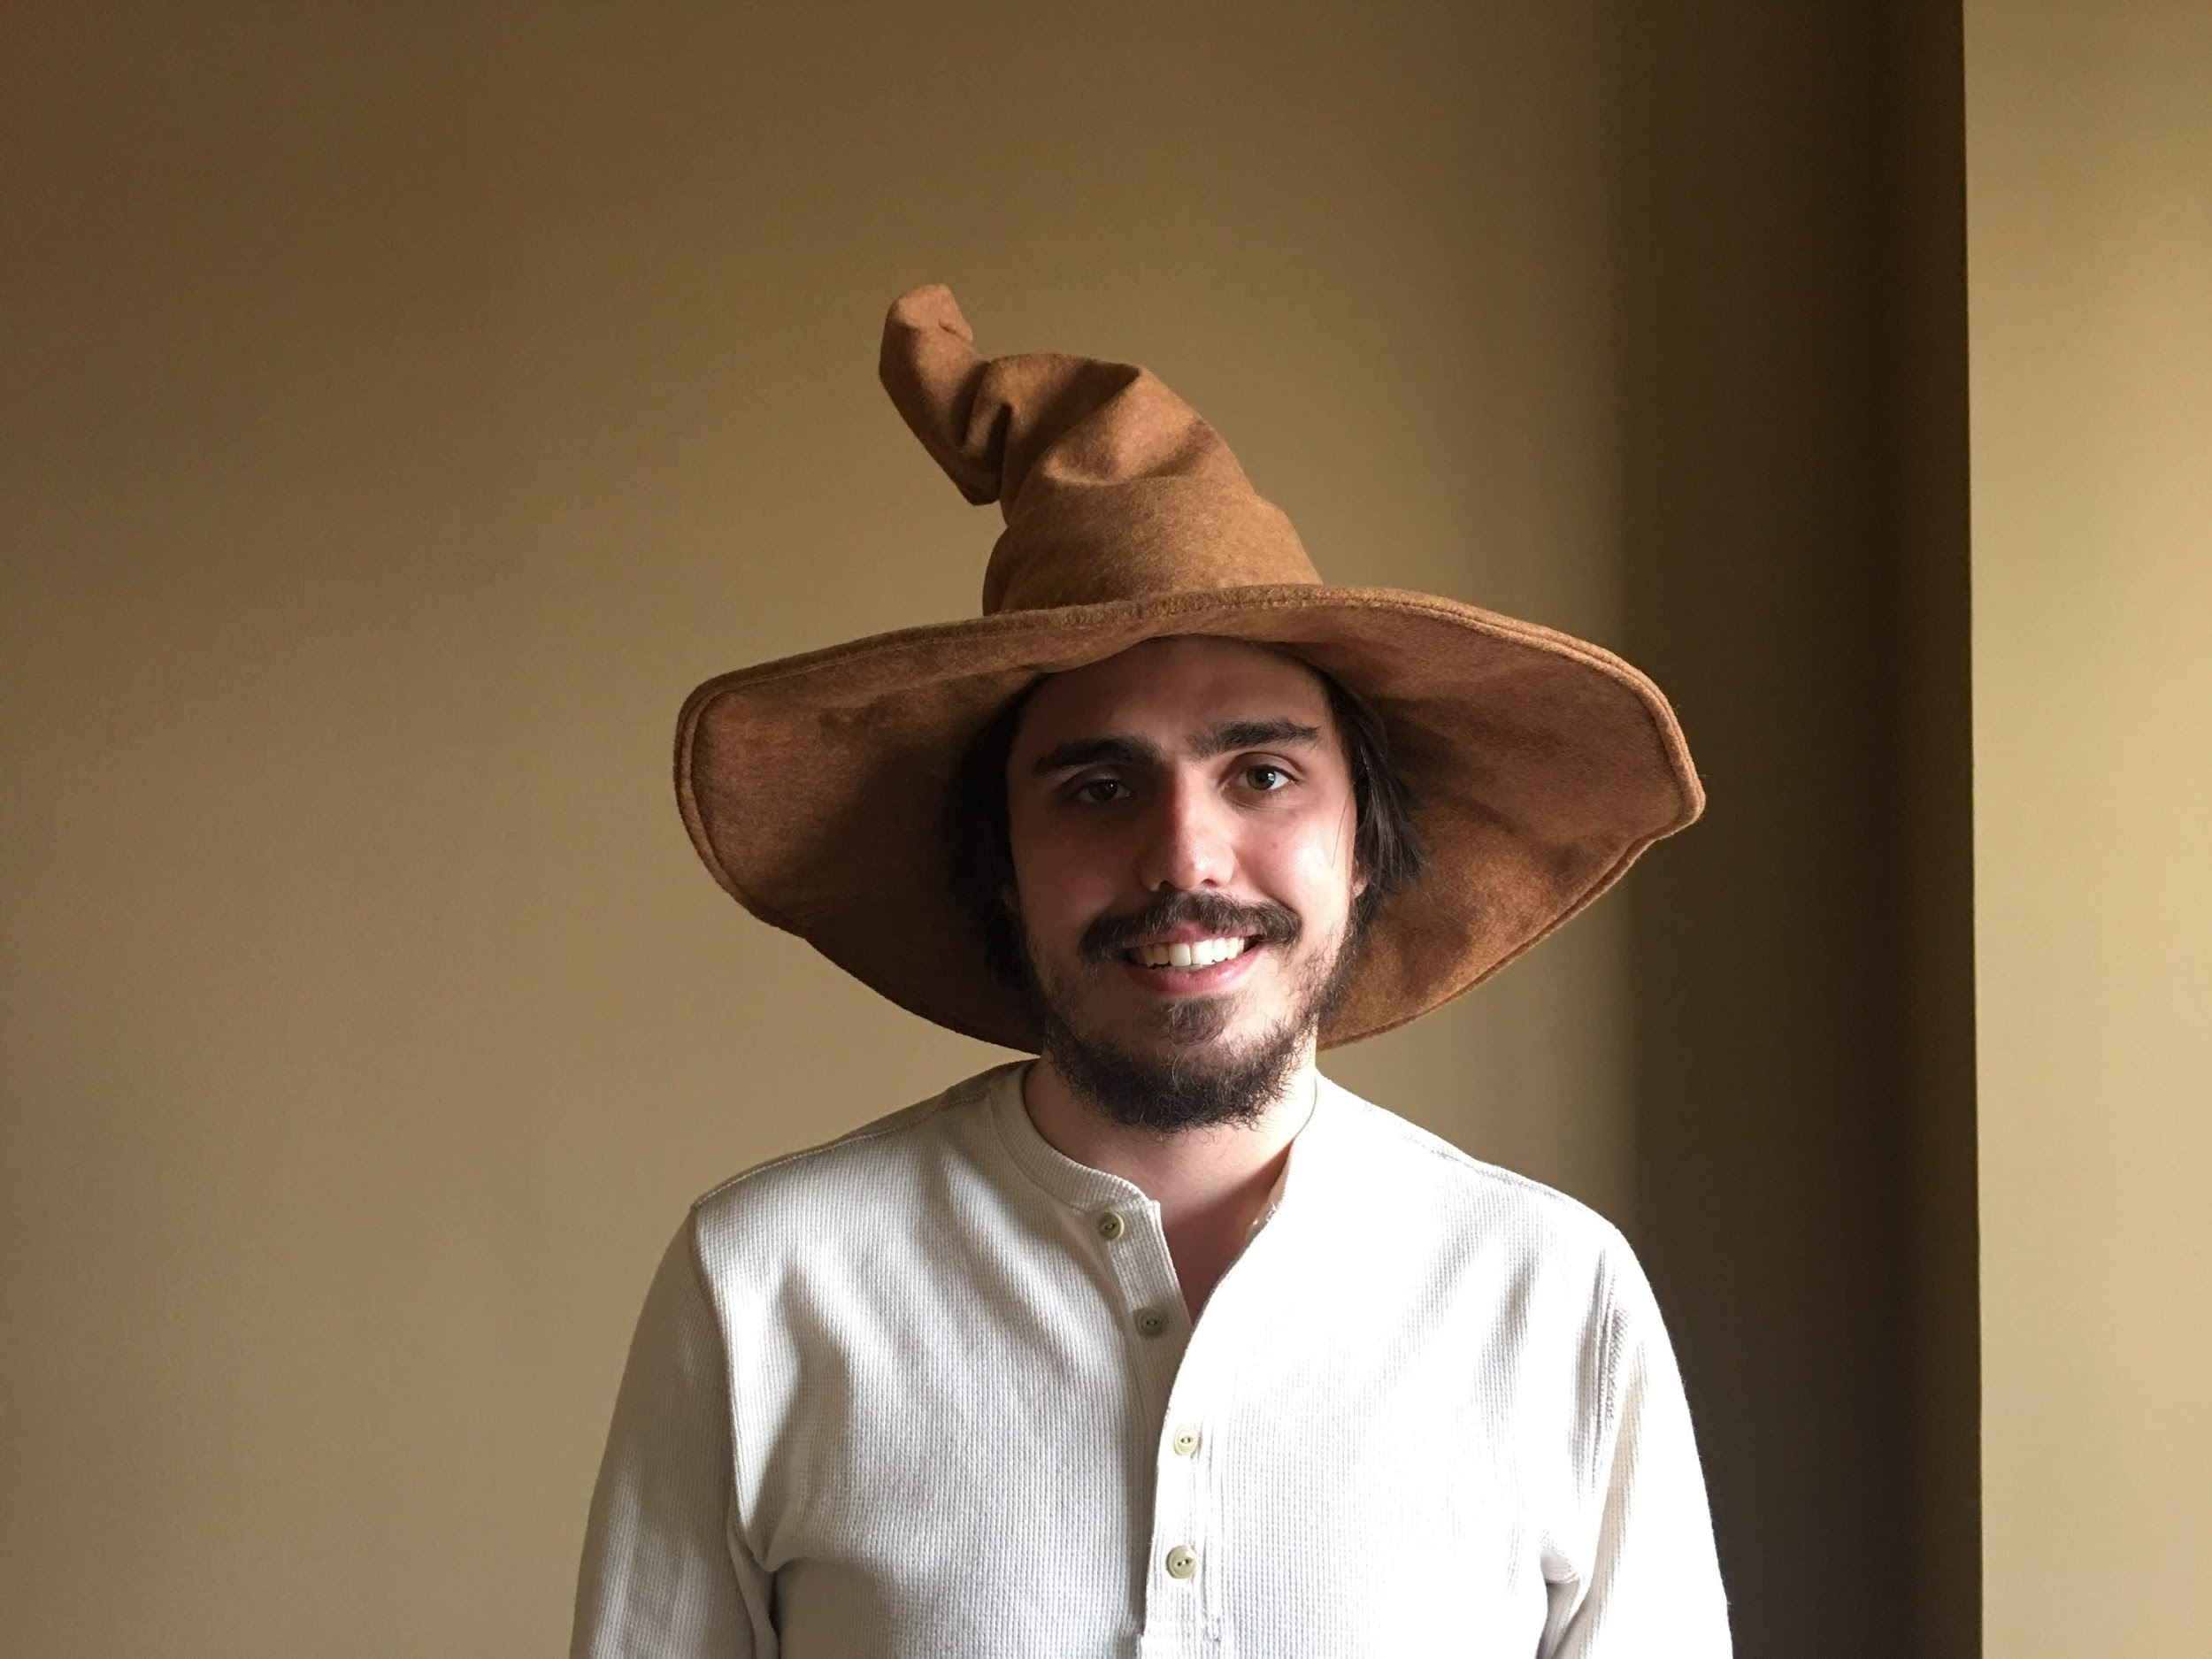
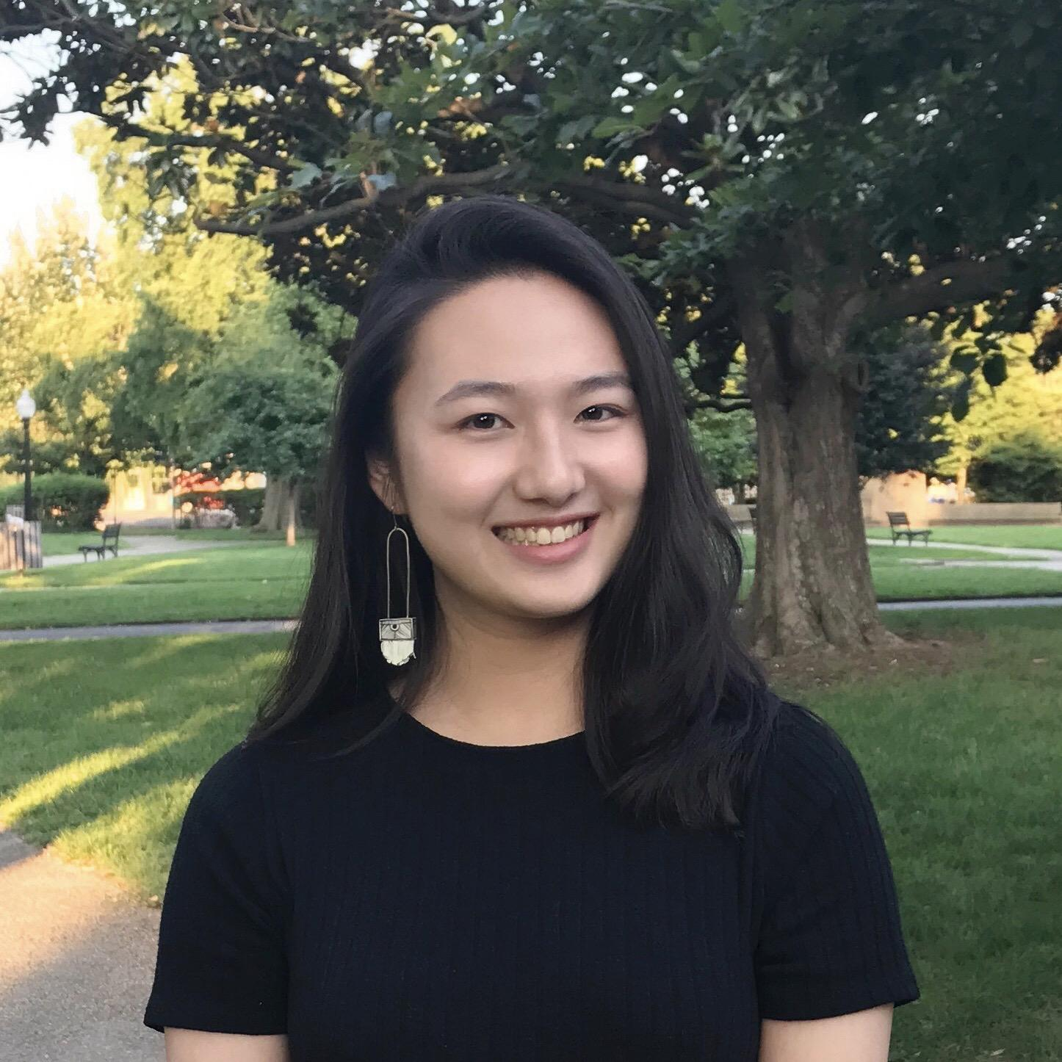
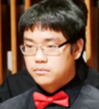
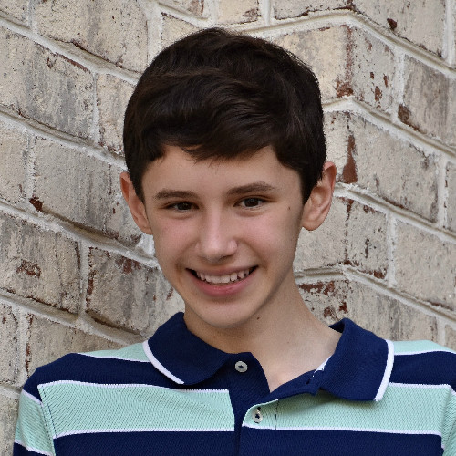
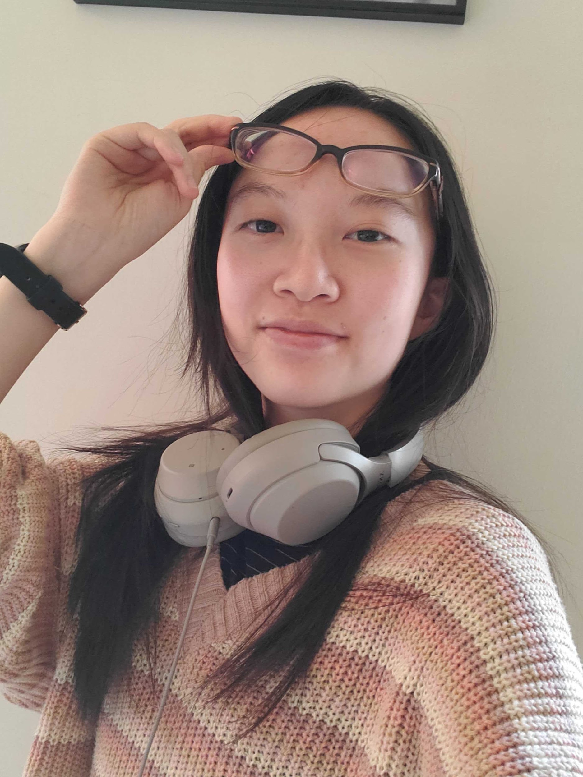
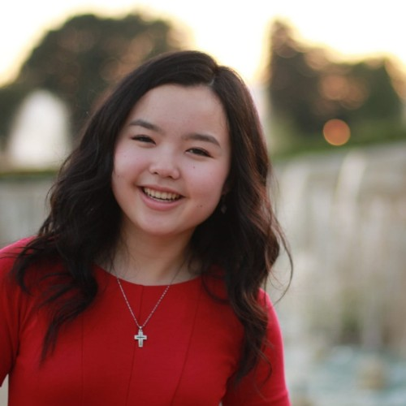
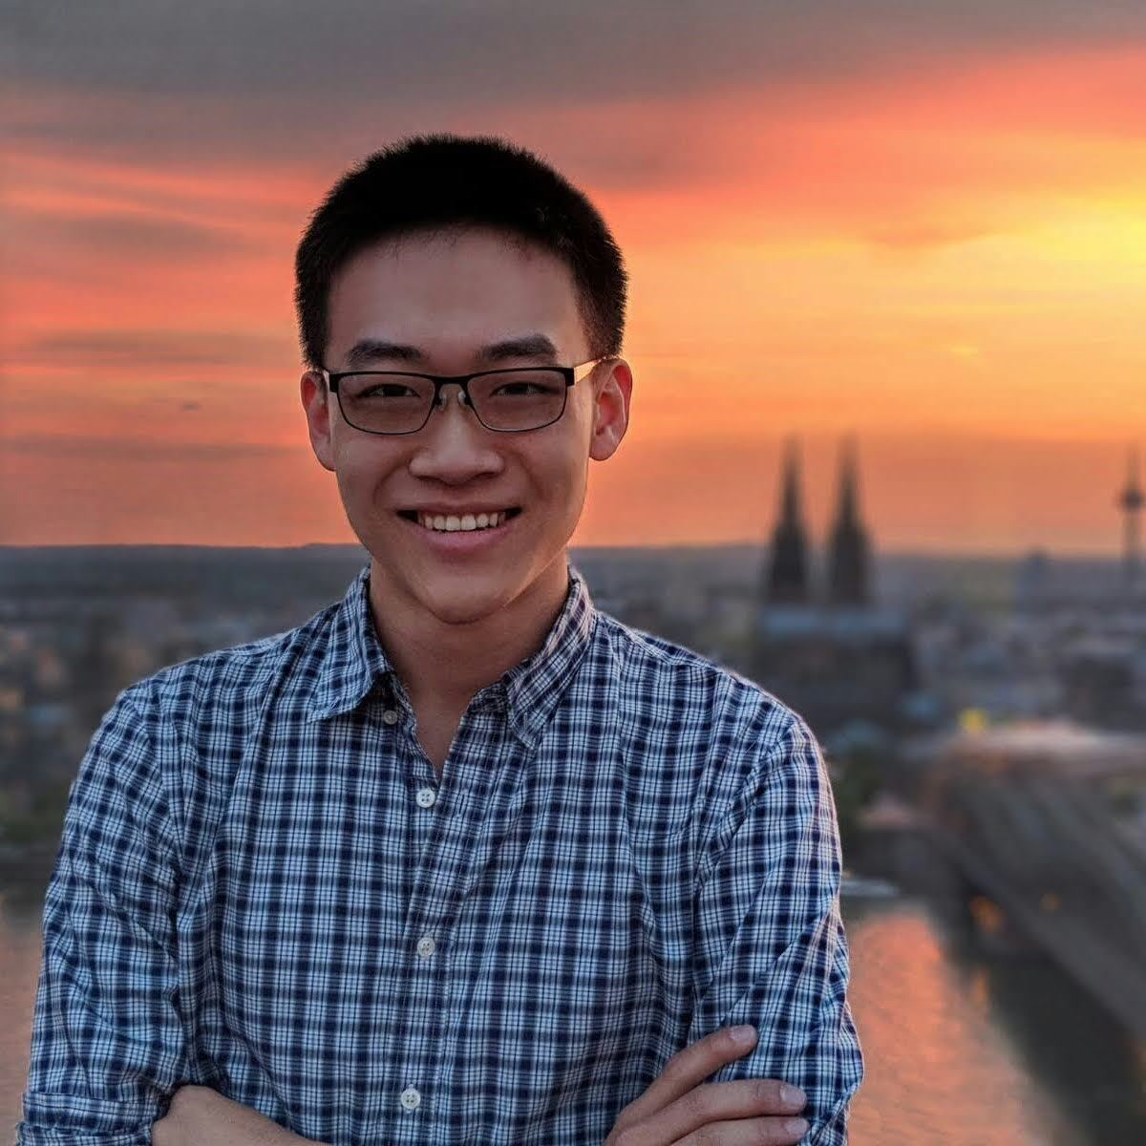
Meet the TA staff!
Emily Gong
MSc
Admin Assistant, Grader
Neyaz Ahmed,
Msc
Grader
Justin Goodman
MSc
Discussion Session Coordinator,
Tutor
Erika Melder
Msc
Assignment Creator, Tutor
Nathaniel Grammel PhD
TBD
Anvitha Bhat
MSc
Tutor
Juan Luque PhD Tutor
Parsa Saadatpanah
PhD
Grader
Danielle Eliav
TBD
Aranya Banerjee
TBD
Navkaran Bindra
BSc
TBD
Tu Luan
PhD
Grader
Vaibhav Gupta
BSc
Grader
Bryce Toole
MSc
Tutor
Auguste Gezalyan
PhD
Tutor
David Chan
PhD
TBD
Yang (Trista) Cao
PhD Grader
Jason Kuo
MSc
Grader
William Gerst
BSc
Tutor
Susan Liu BSc
Tutor
William Cao
BSc
Grader
Sally Zhao
BSc
Tutor

Slide 7




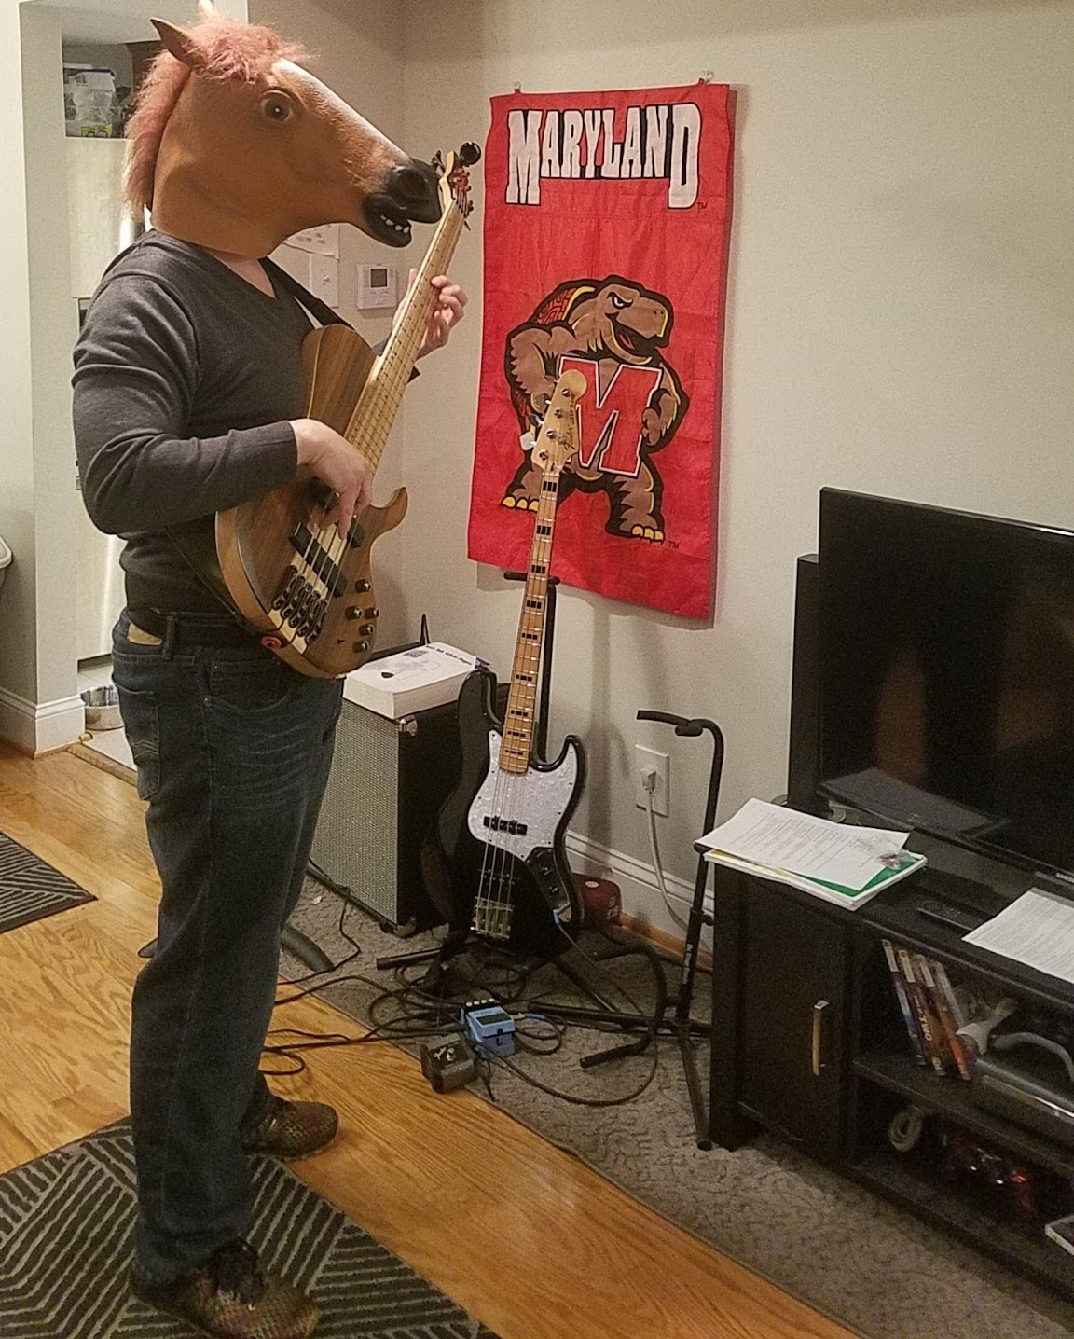

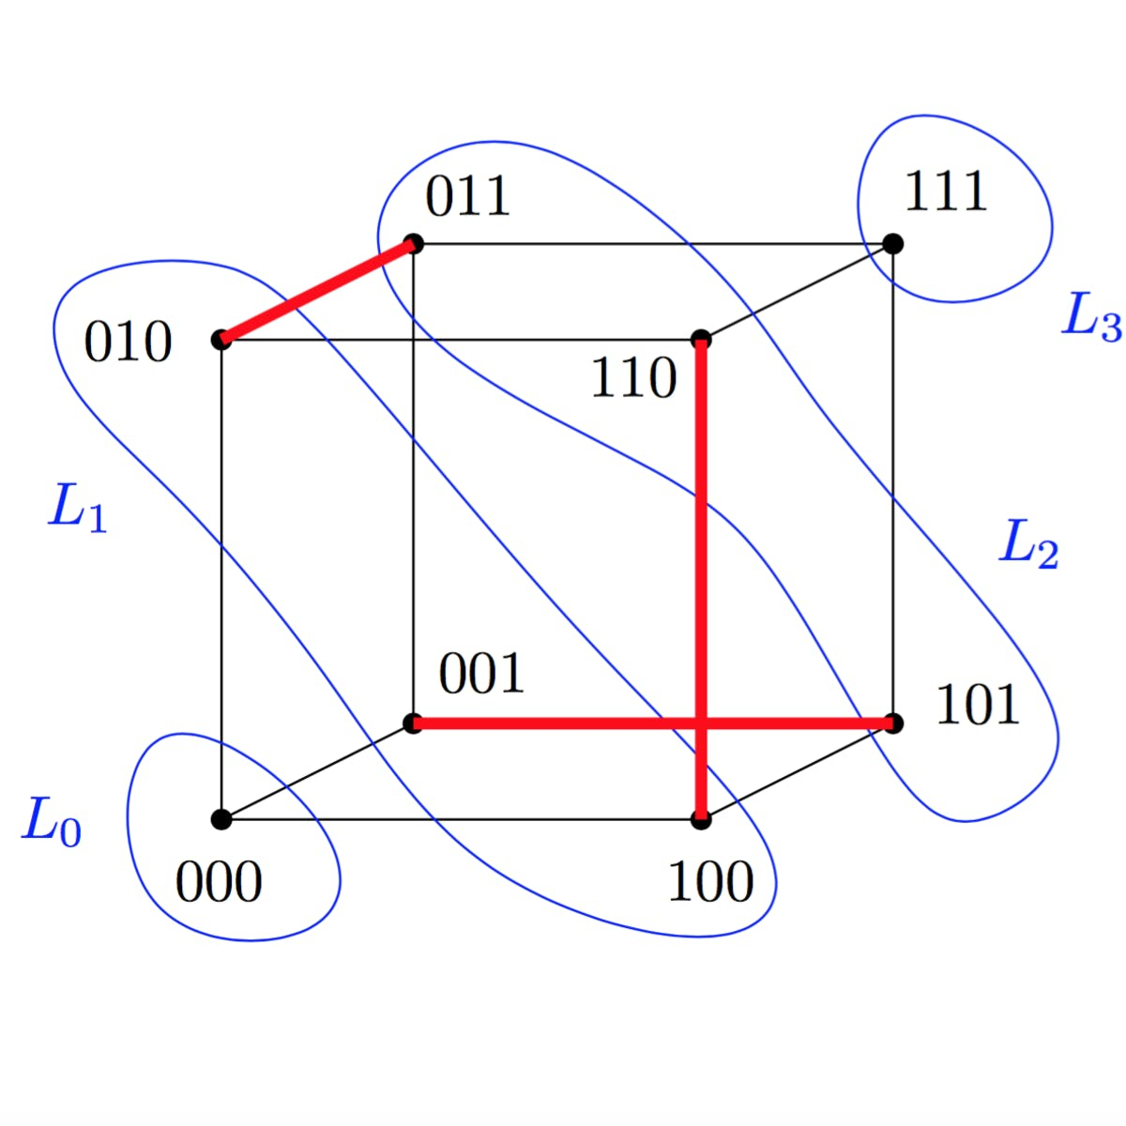

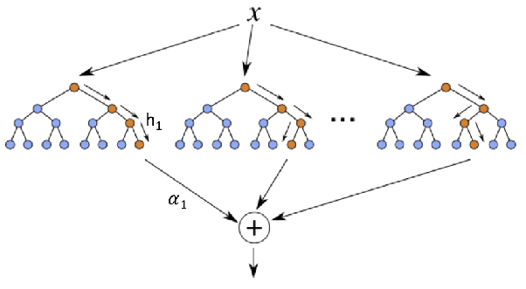

Your instructor
Alumni (BSc)
Jason Filippou (“Phil-ee-pooh”).
Preferred pronouns: I prefer people don’t address me, talk to / about me or acknowledge my presence at all. Beyond that, he, him, his.
Pros: knows cons.
Cons: None.
Nationality
Religion #1
Religion #2
Alumni (MSc)
Former Research Fellow
CMSC250: Discrete
Structures
CMSC420: Advanced Data Structures
SciPy, Pandas for
CV / ML projects
SpringBoot for RESTful web services
Natural habitat

Slide 8
1st week schedule
Check out intro video if you haven’t already.
This first week:
No homework given
No discussion session Monday (yesterday)
We will have a discussion session Wednesday (tomorrow)!
You will have a short, autograded quiz on Friday morning, to be handed in through Monday evening.
Content of the quiz: Our two first lectures.
Office hours will begin Wednesday (tomorrow).
Mine: Mon, Fri, 9 - 11AM. Organized some Zoom links on ELMS.
TAs’: By the time of this lecture, we might have already shared a spreadsheet with you.
ADS - assisted students: thank you for contacting me.
Received a lot of ADS e-mail, sorting through all student cases.
Do my Friday Office Hours work for chatting, if we need to?

Slide 9


Your patience appreciated….
≅ 200 of you joined a few days ago, and we scrambled for new TAs!
Also, some sections are quite small and thus prone to merging. 2x
But no matter what happens, we have TAs ready to go and fill in any gaps.

Slide 10















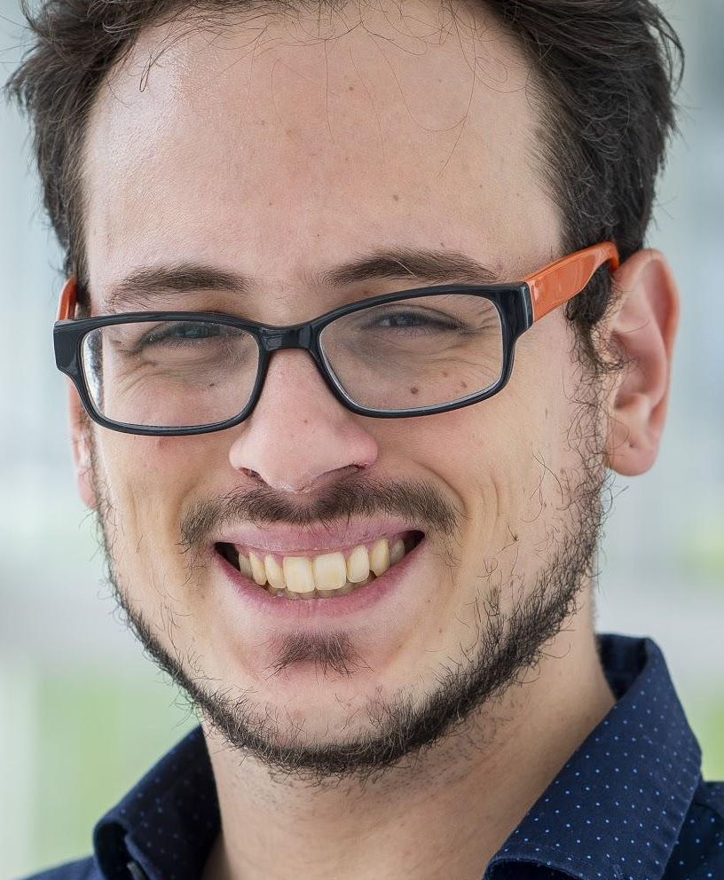


Tech
Announcements and gradebook management (automatically added when you register in class)
Assignment upload and
grading (automatic invite with your ELMS e-mail)
Oh yeah
Offline videos (tutorials, cool stuff)
Class forum (automatic invite with your ELMS e-mail)
Lectures / Office Hours
Instructor & TA Tools
Class brand promotion

Slide 11

And now a message from our sponsor

Slide 12
Exams, homeworks, quizzes, etc

Slide 13
Your weekly 250 schedule
Week
x
Sun
Chill
Mon
Discussion session
Tue
Lecture
Wed
Discussion session
Thu
Lecture
Fri
Chill
Sat
Chill
Hw Late
Hw Early
Short quiz
Week
x+ 1
Sun
Chill
Mon
Discussion session
Tue
Lecture
Wed
Discussion session
Thu
Lecture
Fri
Chill
Sat
Chill
Homeworks: 20% of total grade
Late penalty for a homework is 50% off
Quizzes: 10%

Slide 14
Homework Submission
Submit in any sheet you have, and appropriately label your answers before you upload on Gradescope.
We will post a video tutorial for doing this effectively!
And now, for the first time ever in CMSC250 (*), you can submit your homeworks in LaTeX for 10% extra credit each!
We will post the LaTeX sources for the homeworks on ELMS.
Jason will give you a short LaTeX tutorial geared towards the template we use.
We will NOT teach you LaTeX; here's the standard reference.
https://tex.stackexchange.com/ is a great resource for Q / A
https://www.overleaf.com/ is a browser-based frontend for LaTeX.
(*) Nope.

Slide 15
Quiz submission… TBD
Thinking of leveraging Gradescope-native quizzes. We’ll see.

Slide 16
Exams
Two midterms (both 20%)
Wednesday, Mar 3
Wednesday, Apr 14
We have not decided how we will administer those yet.
One final (30%)
TBD
We have also not decided how to administer the final yet.

Slide 17
Change in ordinary 250 curriculum
Logic
Sets
Proofs
Induction
Relations / Functions
Combinatorics
Countability
/ O() notation / Graphs / other

Slide 18
Change in ordinary 250 curriculum
Logic
Sets
Proofs
Induction
Relations / Functions
Combinatorics
Countability
/ O() notation / Graphs / other

Slide 19
Change in ordinary 250 curriculum
Combinatorics
Logic
Sets
Proofs
Induction
Relations / Functions
Countability
/ O() notation / Graphs / other

Slide 20
Change in ordinary 250 curriculum
Combinatorics
Logic
Sets
Proofs
Induction
Relations / Functions
Countability
/ O() notation / Graphs / other
Rationale:
Offer more honest communication about relative hardness of course.
Logic / Sets fundamental in CS, but a LOT easier than induction / combinatorics

Slide 21
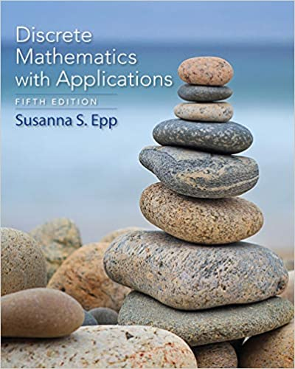
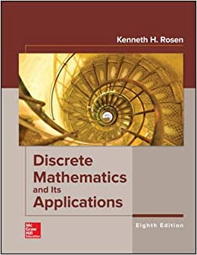
Textbooks (recommended)
We have a large bank of recommended homework problems for both
Rosen: A bit harder, definitely more extensive, and more “Chaotic” w.r.t course structure
Epp: Follows traditional course structure a bit better.

Slide 22

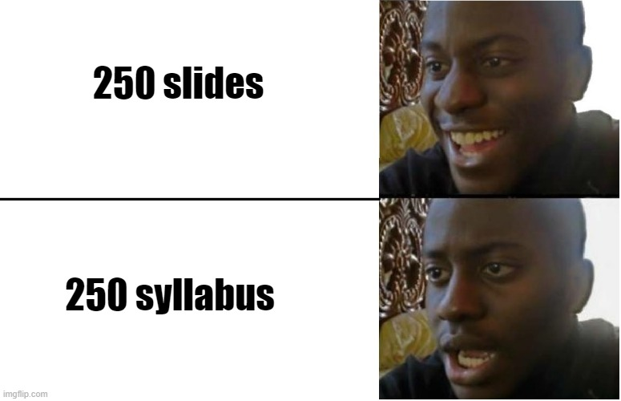
For the rest...

Slide 23


Slide 24
“Discrete?”

Slide 25
“Discrete?”

Slide 26
“Discrete?”
1, 2, 3, 4, ...., 100, ....

Slide 27
“Discrete?”
1, 2, 3, 4, ...., 100, ....
..., -80, -79, …, -1, 0, 1, …., 50, ….

Slide 28
“Discrete?”
1, 2, 3, 4, ...., 100, ....
..., -80, -79, …, -1, 0, 1, …., 50, ….
{s₁, s₂, …., s_{k}}

Slide 29
“Discrete?”
1, 2, 3, 4, ...., 100, ....
..., -80, -79, …, -1, 0, 1, …., 50, ….
{s₁, s₂, …., s_{k}}
….

Slide 30
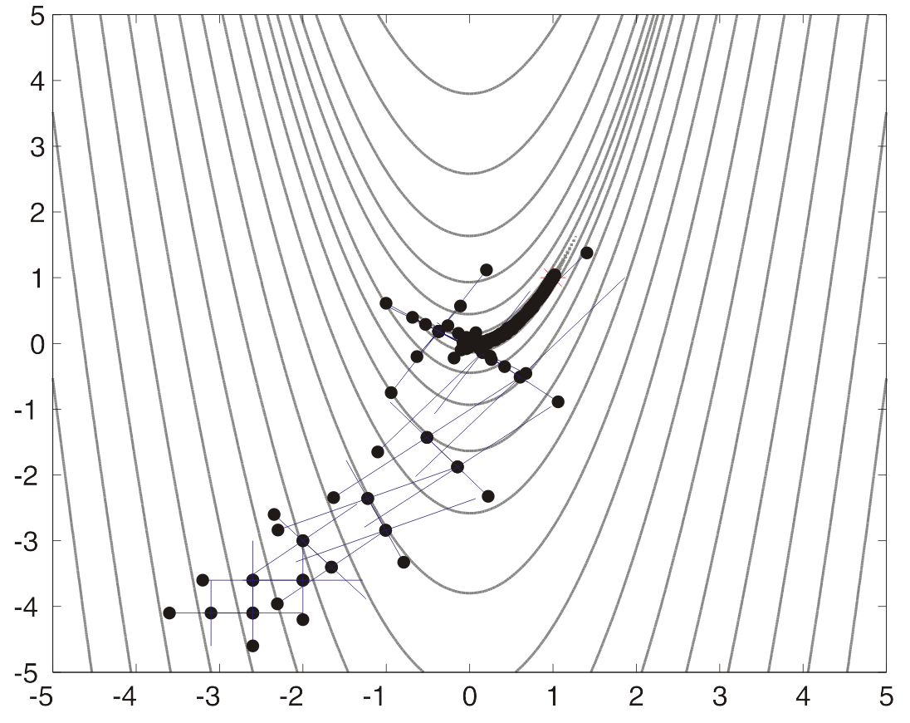
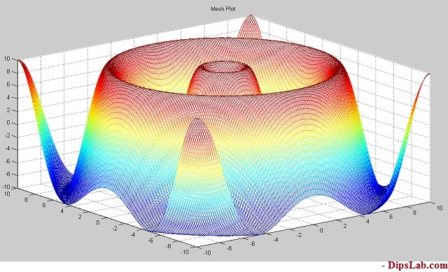
… vs “continuous”

Slide 31
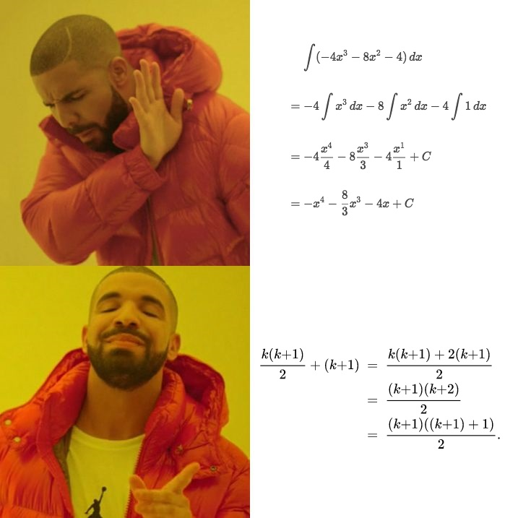
In a nutshell

Slide 32
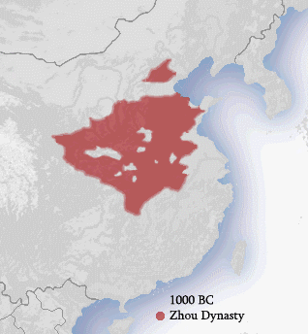
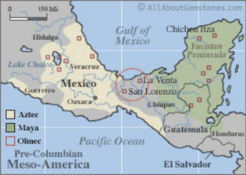
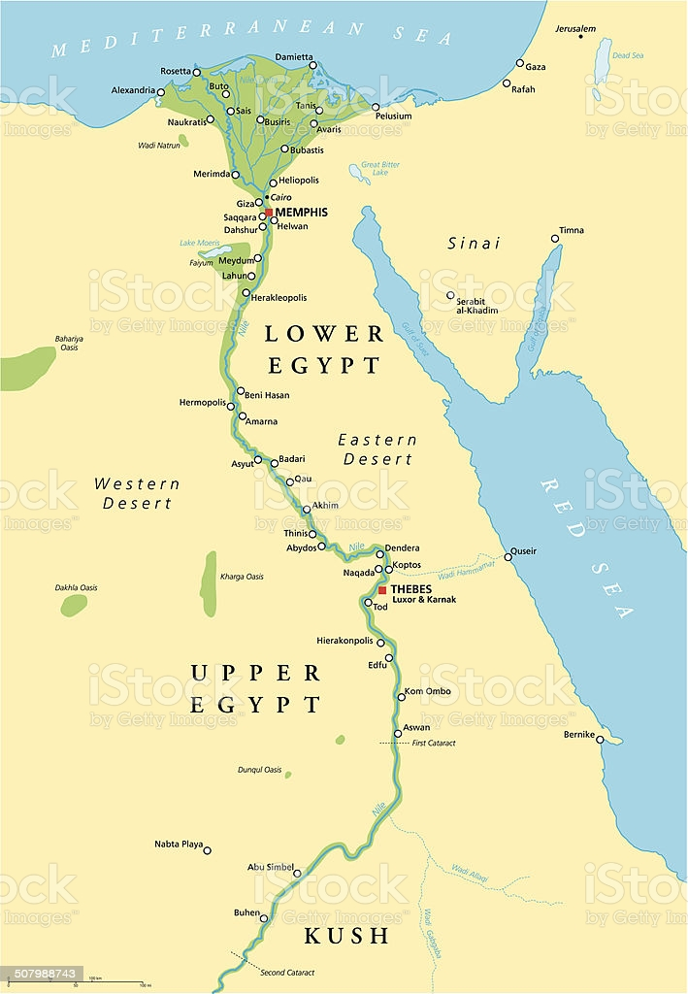
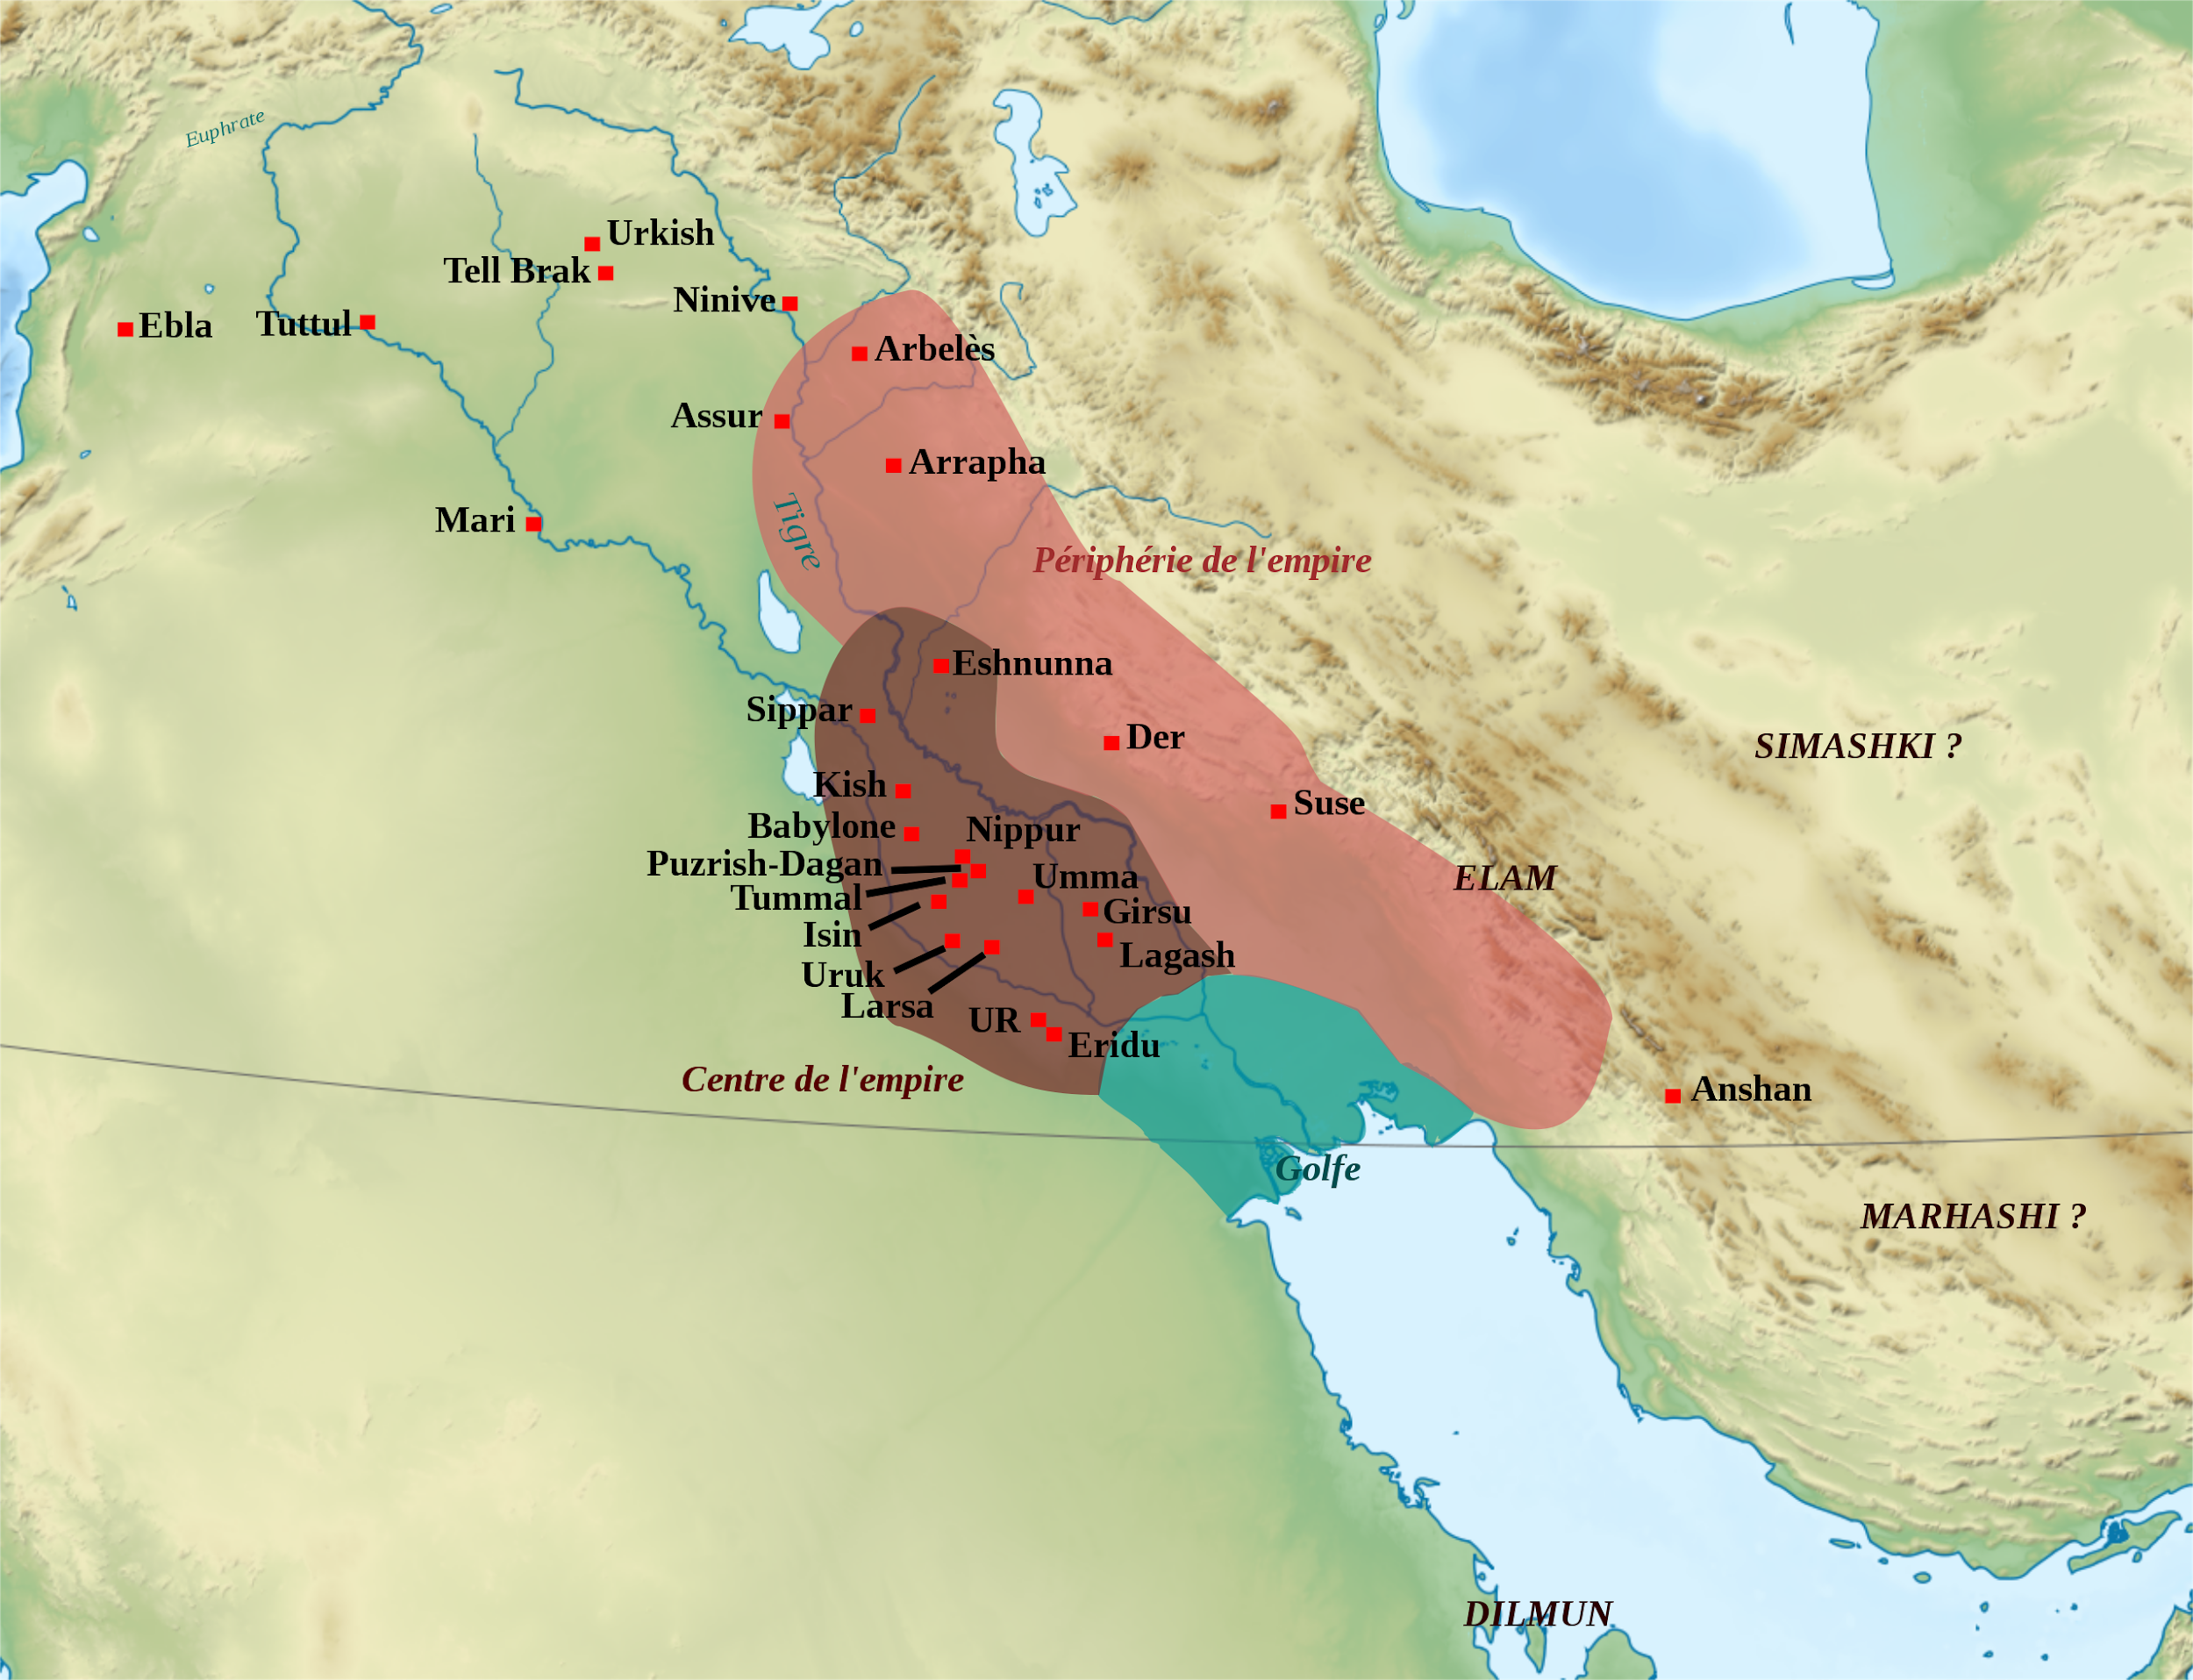
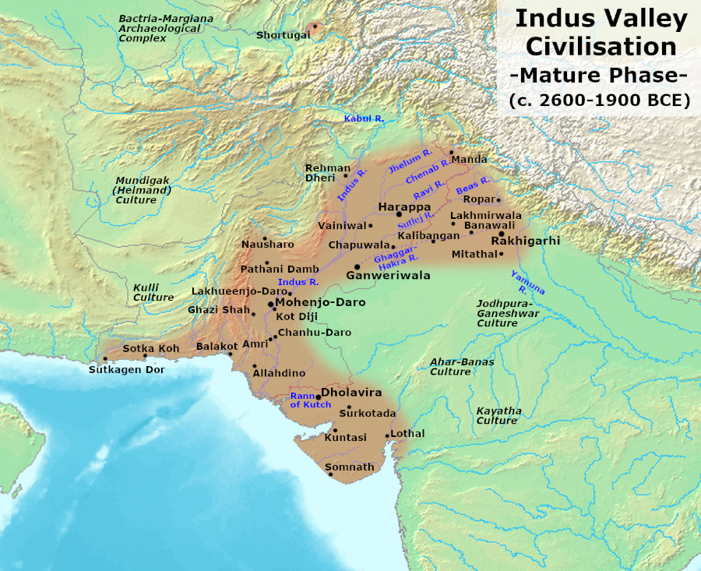
In history
This entire math thing began very practically.
Necessity for calculations / tabulation for astronomy, agriculture, and organizing livestock / supplies

Slide 33
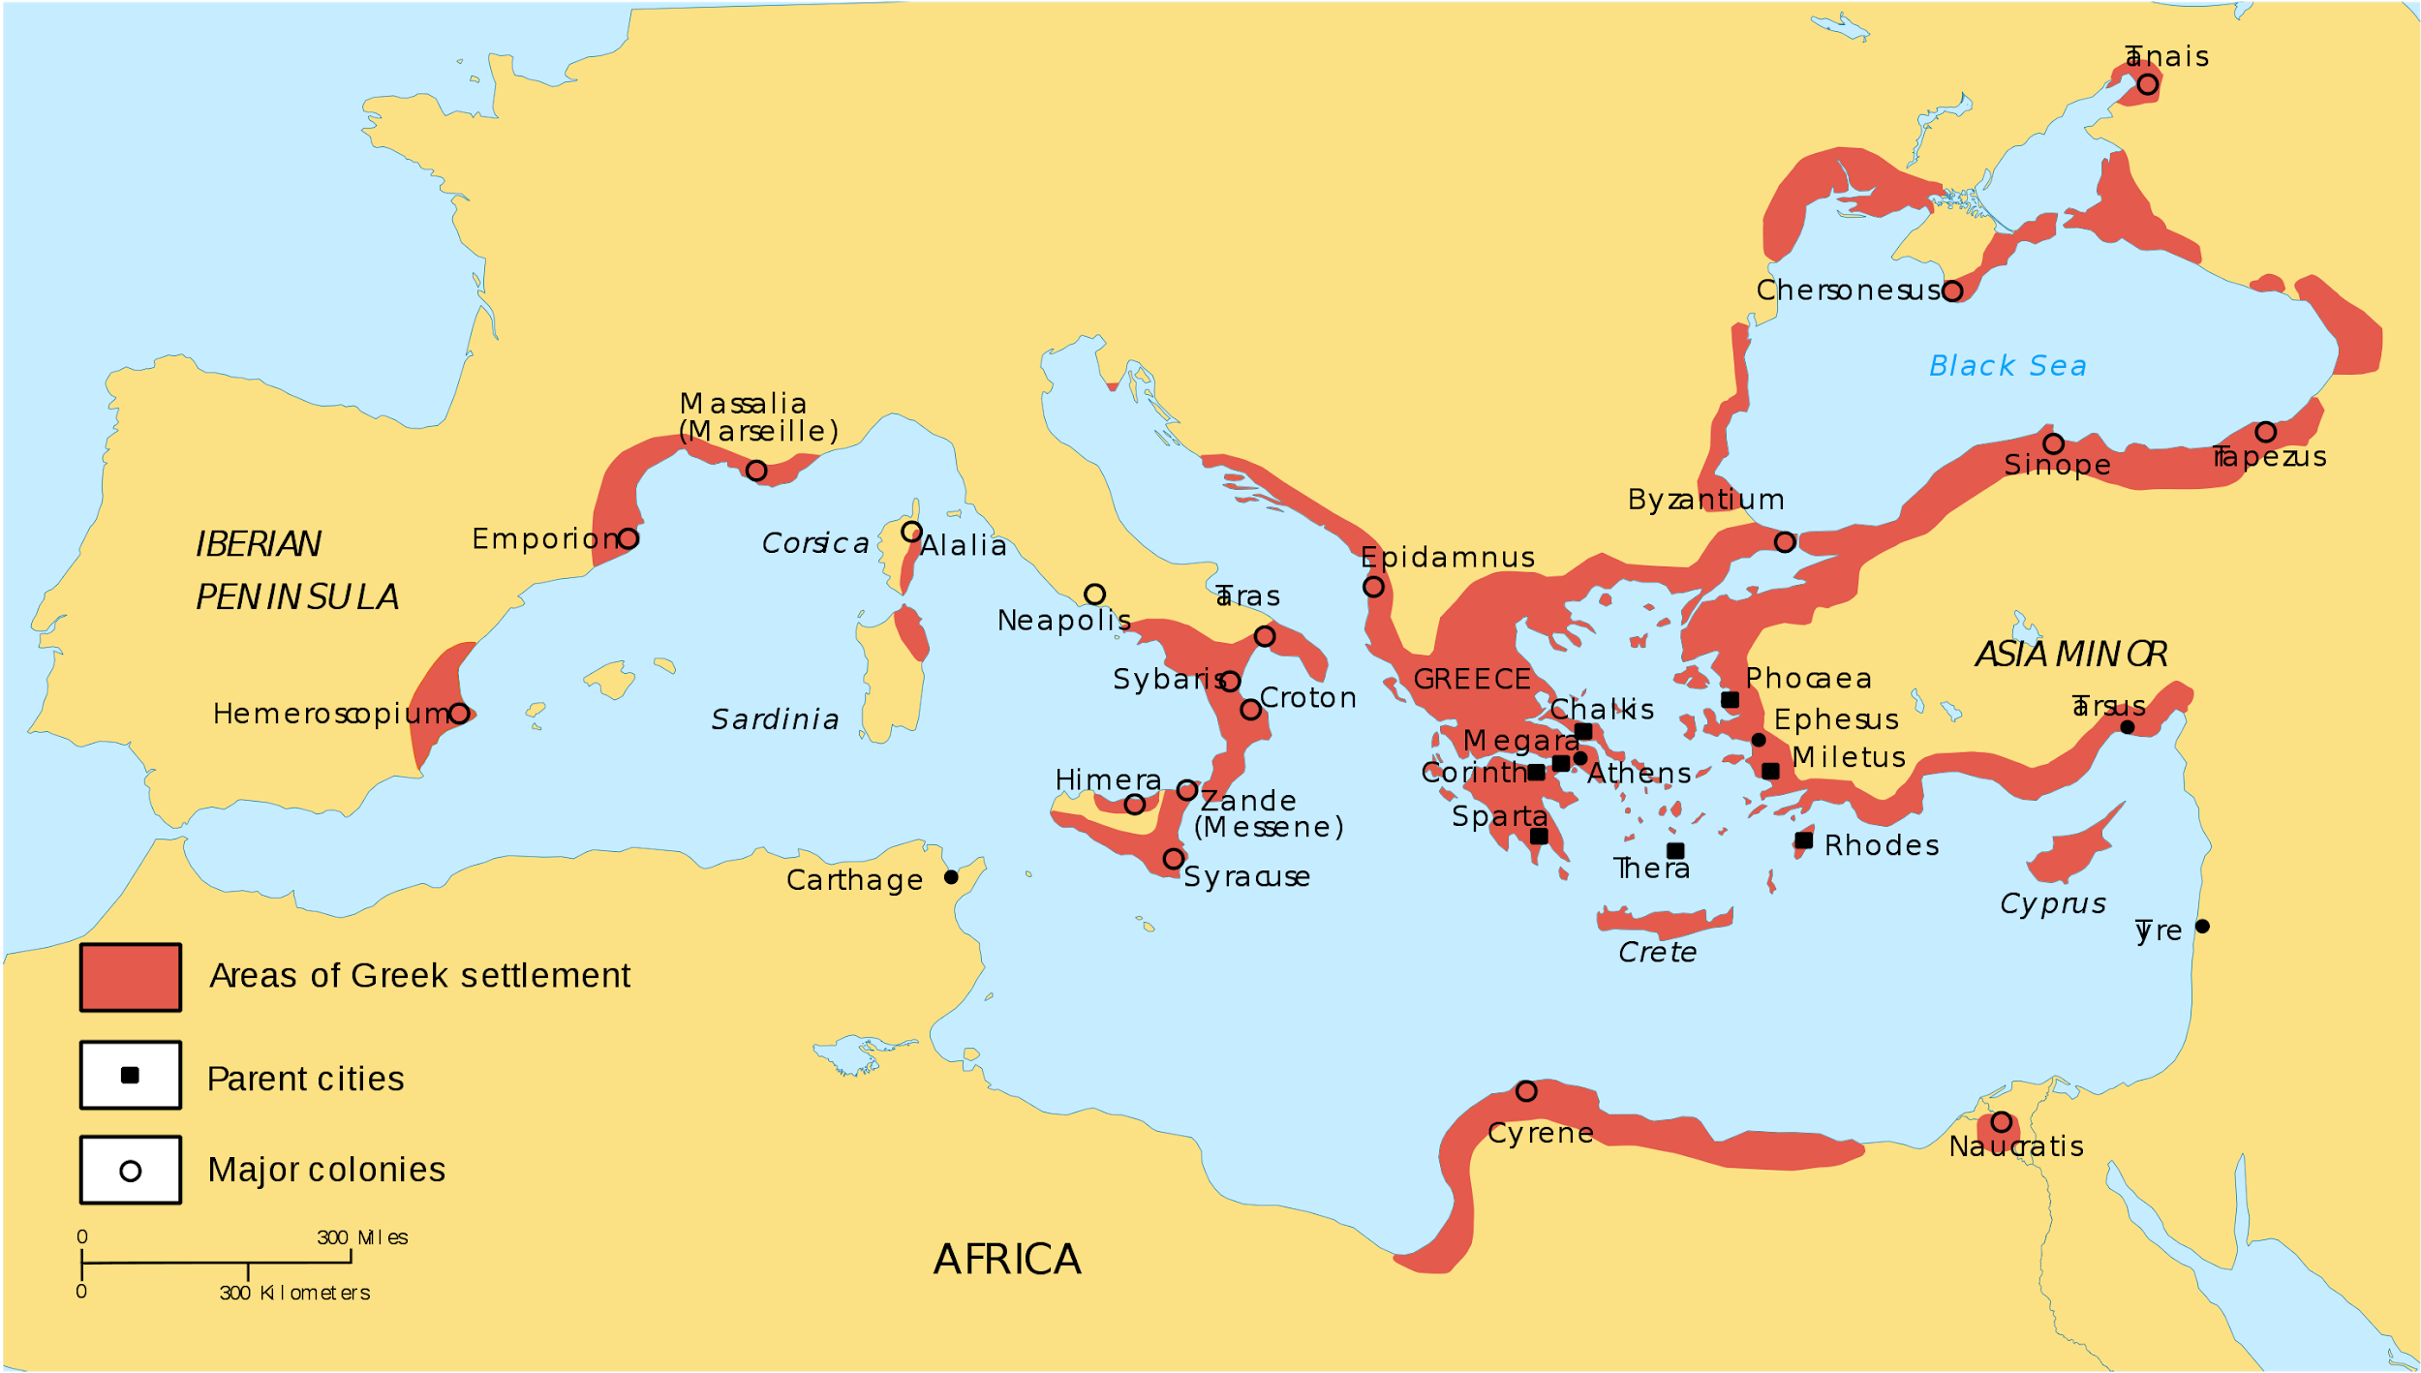
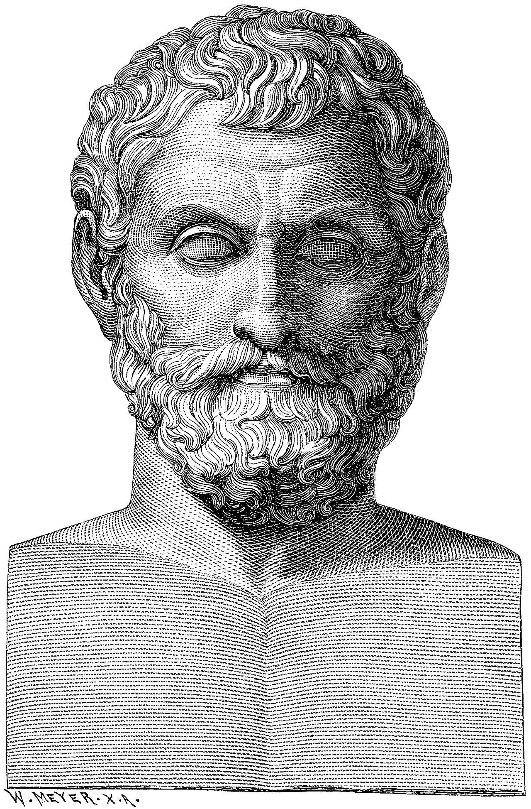
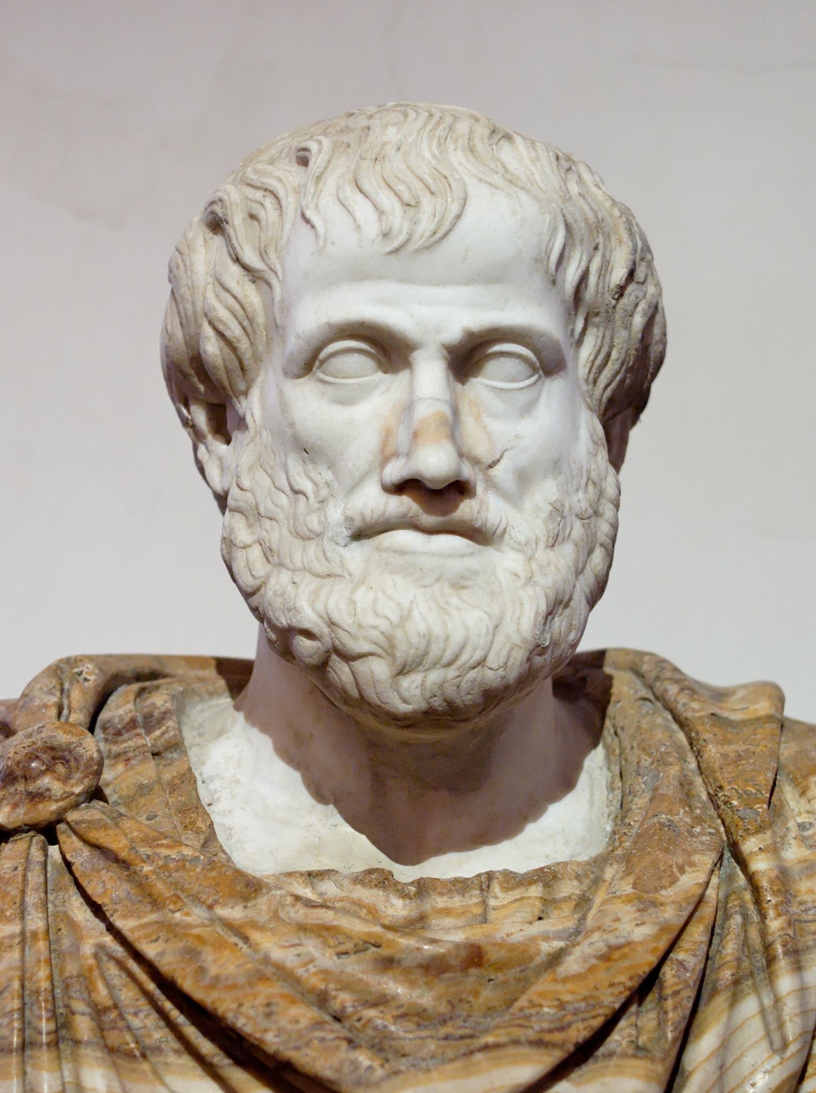
Enter Greeks
Pythagoras
Euclid
Aristotle
Thales

Slide 34
The variable
François Viète, Rennaisance - era French mathematician is often credited as the first person who systematically used letters to name unknowns, which we now call variables
But the Ancient Greeks were the first people to understand this idea deeply.
They didn’t explicitly say “multiply w by h to get area”, but they did understand that to do so is correct even if you don’t have all the numbers a priori!
Famous example: square root of 2.

Slide 35
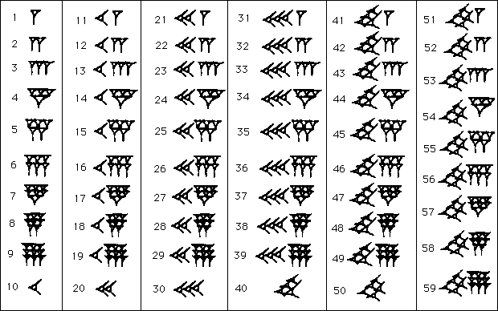
Reasoning about root 2 - Practically
Babylonians:
Came up with an algorithm for approximating ANY root as well as one can!
We still use this method today!

Slide 36
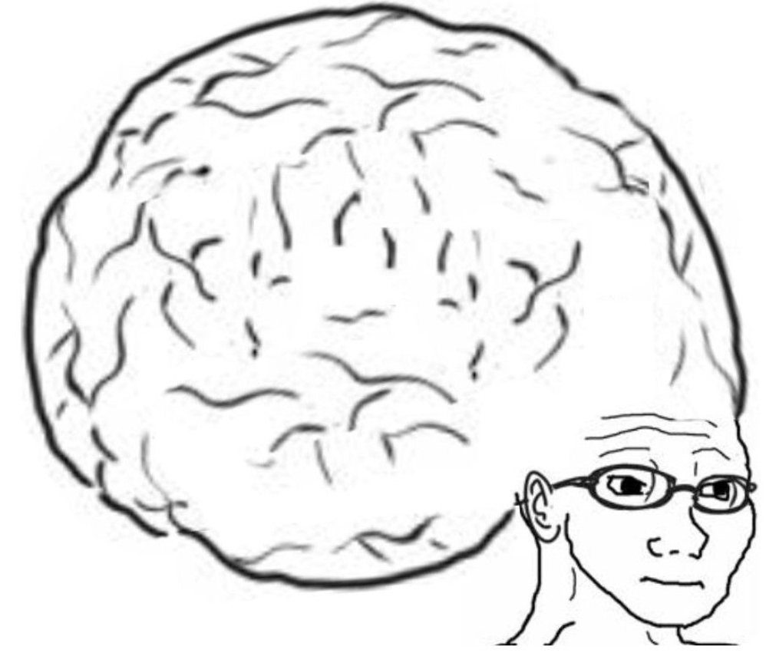
Reasoning about root 2 - “Purely”
Greeks:
Take a right and isosceles triangle, with sides length 1. By pythagorean theorem, the hypotenuse has length root(2).
The more they reasoned about the length of this hypotenuse, they found it is “immeasurable” w.r.t the other sides (i.e they couldn’t find a fraction to relate their lengths)!
Without a single calculation or an example of any kind, Euclid proved that there is no fraction that fully characterizes the root of 2, no matter how much you try!
So the Babylonians would have to spend exactly one infinity to reach their goal!
1
1

Slide 37
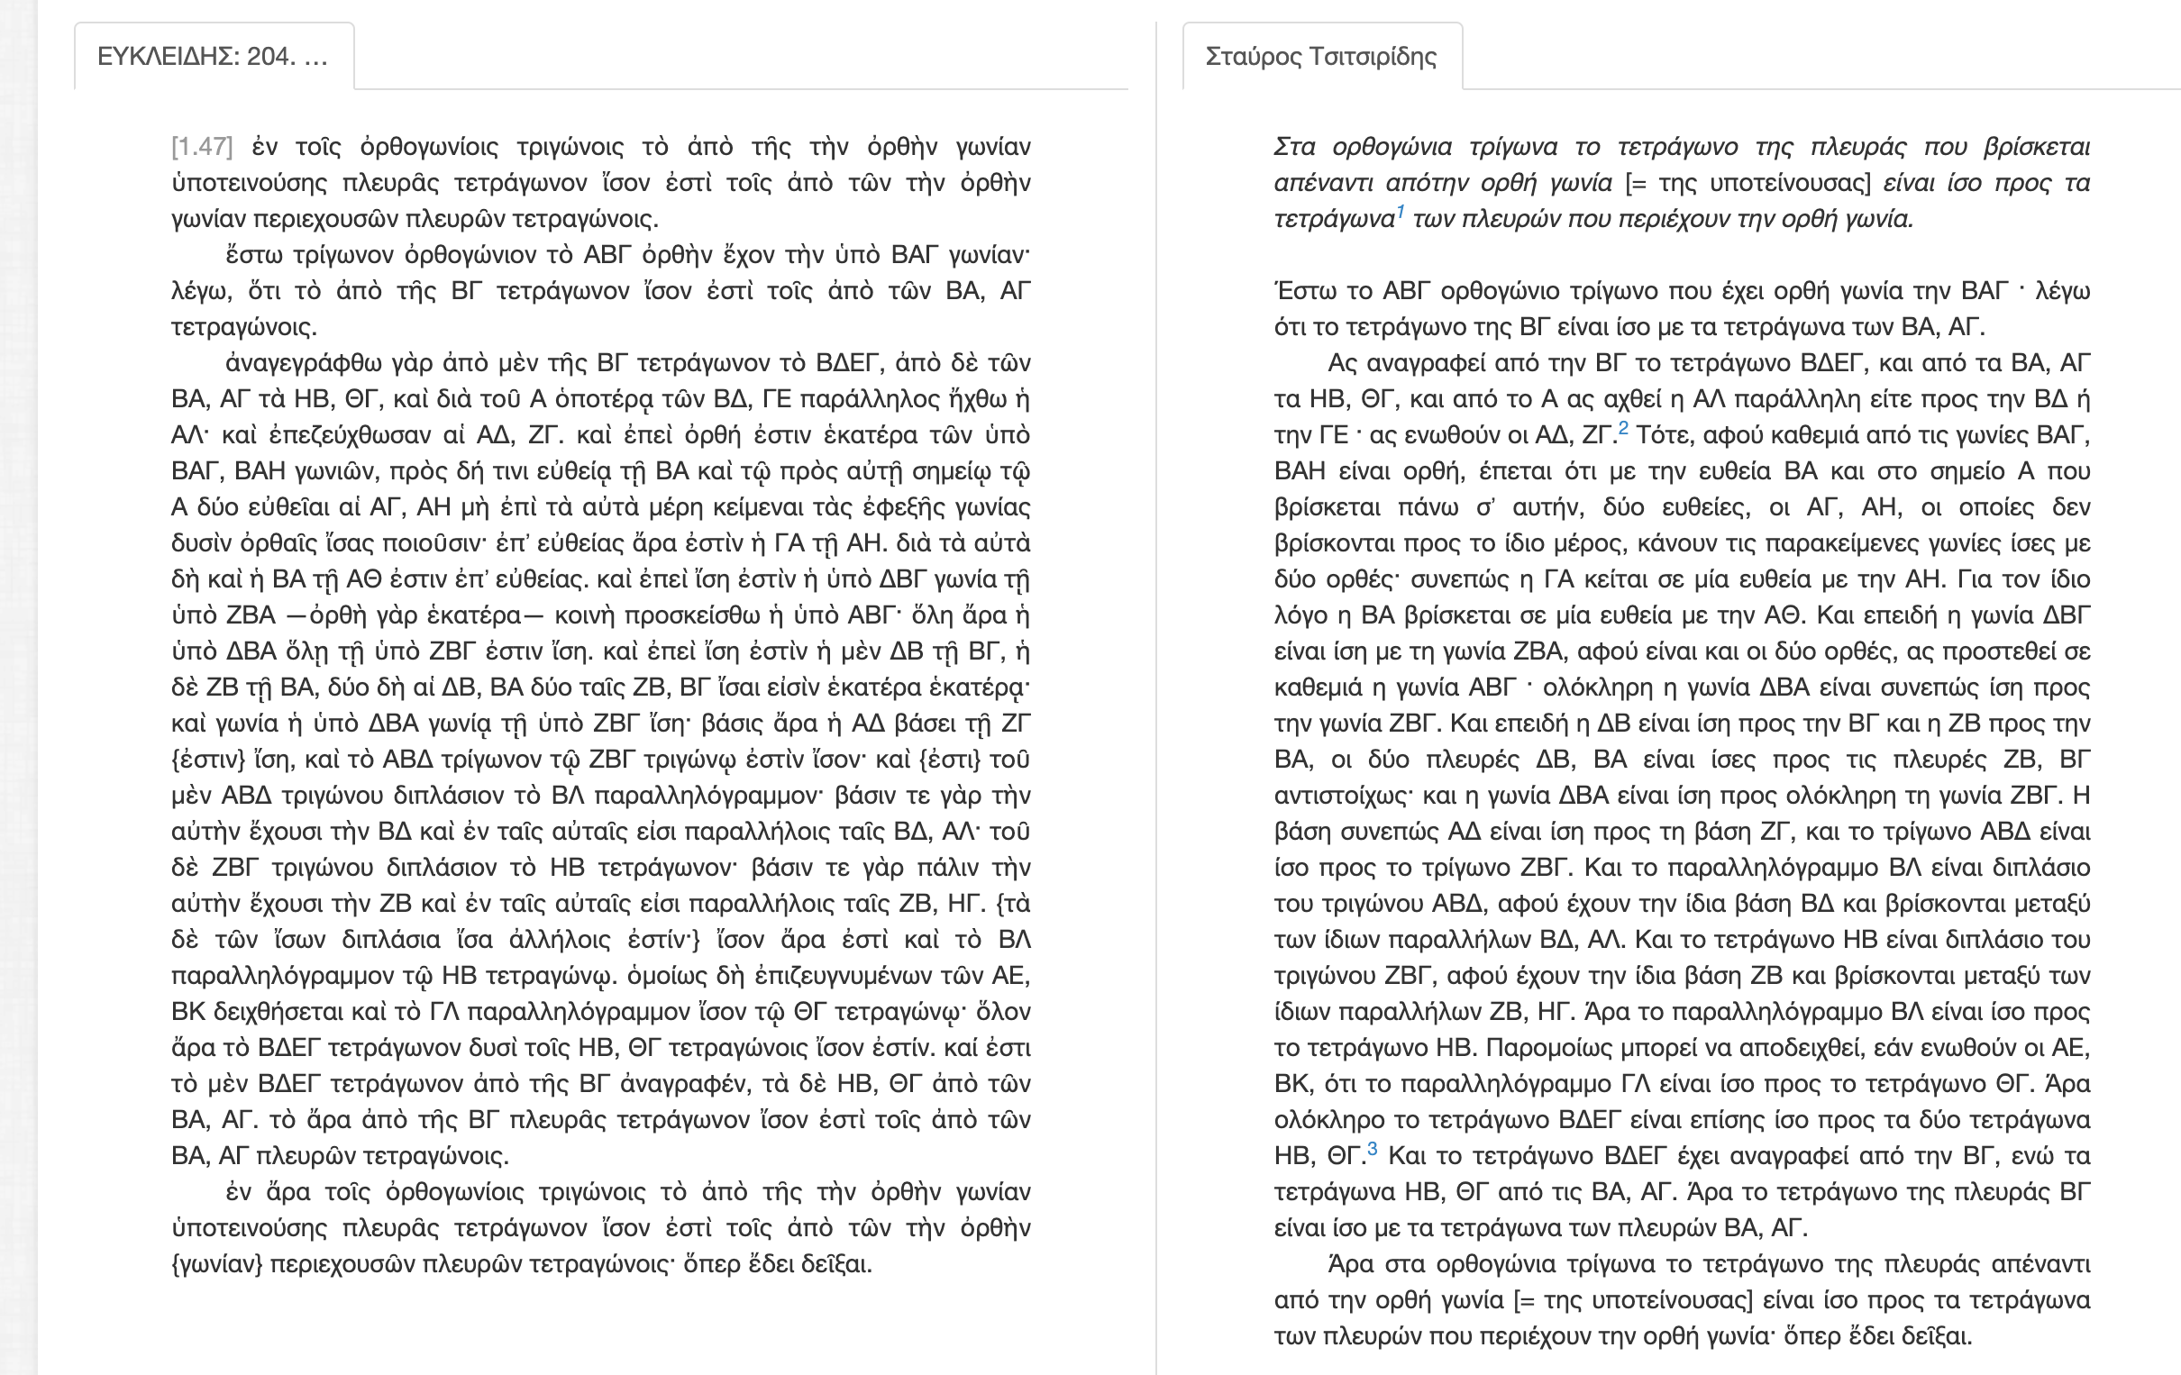
Euclid’s proof of Pythagorean Theorem
(he also proved that root 2 is irrational, a proof we’ll work a lot on)
Modern Greek translation
by a dude called Stavros
Ancient Greek
Jason can give an English translation if you ask real nice
Notice the distinct lack of any numbers. It’s a proof. You shouldn’t need specific numbers to “make it work”.
Till the Greeks, nobody had figured that out.
Notes:
Note that the Pythagorean Theorem was known to the babylonians even before Pythagoras, himself long dead before Euclid was alive. So it’s completely reasonable, chronologically speaking, that a proof of the theorem by Euclid exists.

Slide 38
Rest of this week
Wednesday: your first discussion session, at your allotted time.
Check the discussion session spreadsheet that was shared with you on ELMS yesterday night.
Thursday: our second lecture, in combinatorics.
Office Hours spreadsheet posted on ELMS some time today.
Friday: expect a quiz on first week’s lecture content.
Thanks a ton for stopping by, EH?

